Slide 1
Kick-off Webinar
Kick-Off Webinar:
Innovations in Nutrition Programs and Services
2022 Grantees
Administration for Community Living
Administration on Aging
August 10, 2022
Notes:
Judy-
Hello and welcome to the Kick-off webinar for the 2022 Innovations in Nutrition Programs and Services grantees. We are pleased that you could join us today to get the grant year off to a great start.

Slide 2

Welcome 2022 INNU Research and Replication Grantees!
Notes:
Judy-
Congratulations to you all. As you know, the grant competition was highly competitive. An independent panel of experts in aging, public health, evidence-based programming, and academia reviewed your application and scored it. The top three research applications were awarded along with the top seven replication applications.

Slide 3
Agenda
Administration for Community Living (ACL)
Older Americans Act
Innovations in Nutrition (INNU) Grant Program
2022 INNU Grantees
National Resource Center for Nutrition and Aging (NRCNA)
What’s Next?
Notes:
Judy-
Today’s webinar will cover:
Administration for Community Living (ACL)
Older Americans Act
Innovations in Nutrition (INNU) Grant Program
2022 INNU Grantees
National Resource Center for Nutrition and Aging (NRCNA)
What’s Next?
You will have an opportunity to ask questions at the end of the presentation.
I would now like to introduce our first speaker, Keri Lipperini, the Director of the Office of Nutrition and Health Promotion Programs, also known as ONHPP.

Slide 4
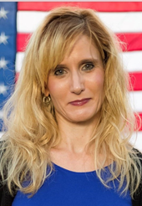
Welcome 2022 INNU Grantees
Keri Lipperini, MPA
Director
Office of Nutrition and Health Promotion Programs
Administration for Community Living
keri.lipperini@acl.hhs.gov
Notes:
KERI
Good afternoon, everyone. I’m honored to join you today. As Judy mentioned, I’m Keri Lipperini, Director of the Office of Nutrition and Health Promotion Programs for the Administration for Community Living. For those of you I may have met at some point along our career paths, you know I have so much passion for senior nutrition and the network who serves this important group of Americans. One of my goals for this office is raise up the weakest link in our network. We can only be as strong as our weakest link. And you will help us do it.
The ACL Innovations in Nutrition grantees create best practices for sharing. Over the course of your three or five-year grant, you’ll develop and implement evidence-based practices for enhancing senior nutrition programs.
Specifically, if you are doing a research grant, you will: Demonstrate Congregate Meal Program Impact on Nutrition, Socialization, Health and Well-being Outcomes, or, you will be developing a program to Evaluate and Sustain Effective, Non-Traditional Senior Nutrition Program Delivery Models. If you are doing a replication grant, you have chosen from four previously successful grants and show how they can be replicated with different populations.
The learnings from our grantees have pushed our network to be stronger and better. They have been doing this since 2017. Each cohort of grantees worked hard over the course of their grant to learn and develop. Little did we know that the learnings from our grantees would help provide a compass for all the network on how to deal with the COVID challenges. COVID created an “all hands-on deck,”. ACL worked tirelessly to deliver solutions to our network and our grantees were right there with us. They found solutions to the many challenges we faced. The challenges continue today, especially in light of the new COVID variants. More simply put, we are still facing these challenges, and to what degree is the question. Your work is critical to our network’s continued success.

Slide 5

Mission Statement
Maximize the independence, well-being, and health of older adults, people with disabilities across the lifespan, and their families and caregivers
Notes:
KERI
For the first part of my presentation, I’d like to acquaint you with the Administration for Community Living, referred to as ACL. The mission of our agency is to maximize the independence, well-being, and health of older adults, people with disabilities across the lifespan, and their families and caregivers.
Our goal is for older Americans to live independently and thrive. Our program help with ensuring they have the highest quality of life.

Slide 6
About ACL
Established April 2012
Combined offices -
  Administration on Aging
  Office on Disability, and
  Administration on Developmental Disabilities
For all people, regardless of age and disability, to live with dignity, make their own choices, and participate fully in society
Notes:
KERI
I’d like to tell you a little bit about the history of ACL-
ACL was established 2012 and is an agency that brought together the Administration on Aging, Office on Disability, and the Administration on Developmental Disabilities.
Our agency is structured to provide general policy coordination while retaining unique programmatic operations specific to the needs of each population our network serves.
ACL’s vision is that all people, regardless of age and disability, will live with dignity, make their own choices, and participate fully in society.

Slide 7
ACL Organization
ACL
Office of the Administrator
Administration on Aging
Center for Integrated Programs
National Institute on Disability, Independent Living and Rehabilitation Research
Center for Innovation and Partnership
Center for Management and Budget
Center for Policy and Evaluation
Notes:
KERI
ACL is comprised of 7 units, which are listed on this graphic. This single agency is charged with developing policies and improving supports for older adults and people with disabilities. Your INNU grant was awarded through the Administration on Aging, specifically, in the Office of Nutrition and Health Promotion Programs where we reside.
For the next part of our presentation, I’ll turn the program over to Judy Simon. Judy is our National Nutritionist here at ACL. She tirelessly supports the network in so many ways. You will get to know Judy because she is your Project Officer for your grant.

Slide 8
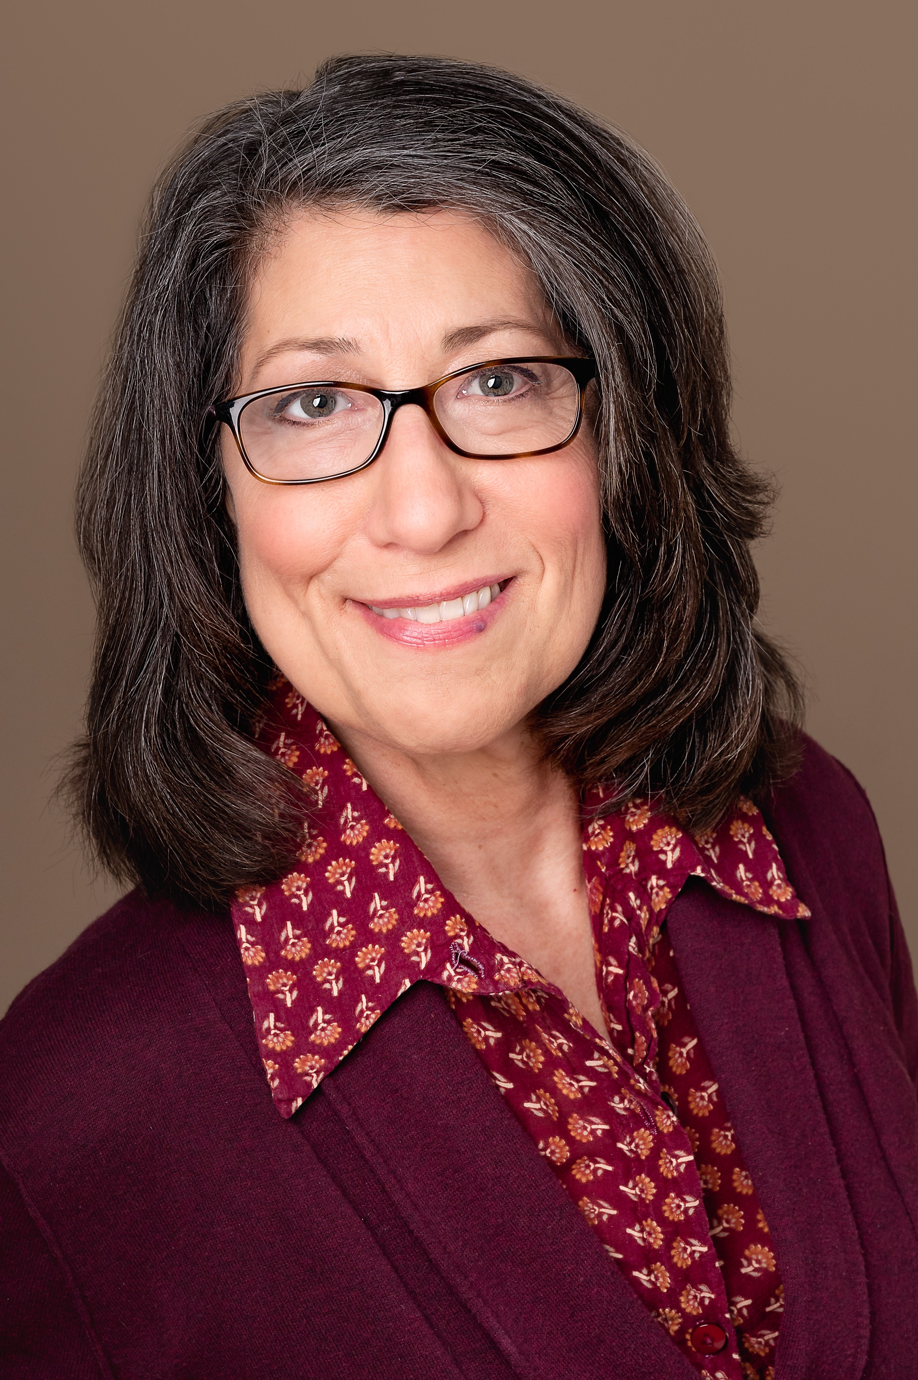
Meet Your ACL Project Officer
Judy Simon, MS, RD, LDN
  Project Officer
  National Nutritionist
  Grant monitoring:
    Programmatic reports
    Calendar of required reports
    Monitoring calls
    Work plan revisions
    Partners with Office of Grants Management staff
  judy.simon@acl.hhs.gov
Notes:
JUDY
Thank you, Keri.
I’m so excited to meet each of your today. As Keri mentioned, I’ll be your Project Officer. I’ve included my contact information on the slide. As an ACL grantee, there are requirements you need to know as you work to fulfill the expectations of your award. I’m always available to answer questions and discuss issues that arise.
The Nutrition Resource Center will be handling your monthly calls and technical assistance. I’m engaged for grant management conversations that require more guidance around policy and procedures . Examples could include issues like work plan revisions, semi-annual reports, and monitoring calls.

Slide 9
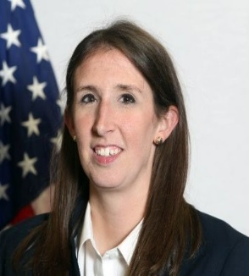
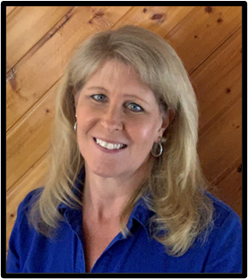

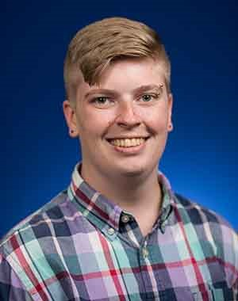
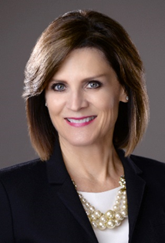
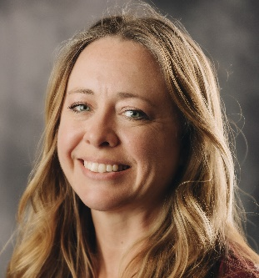
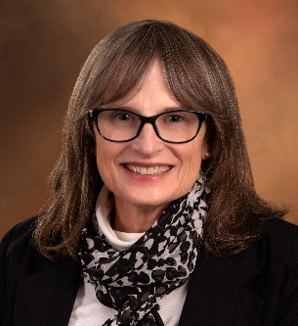
Other Key Staff…
Shannon Skowronski
Team Lead
Donna Bethge
Aging Services Program Specialist
Lesha Spencer-Brown
Aging Services Program Specialist
Monika Anderson
Program Analyst
Kathy Wilson-Gold
Nutrition Consultant
Kathryn Tucker
Nutrition Consultant
Sherri King
Nutrition Consultant
Office of Nutrition and Health Promotion Programs
Notes:
JUDY-
From time to time, grantees do interact with other staff members in the Office of Nutrition and Health Promotion Programs, also known as ONHPP. I’d like to take a moment and acquaint you with our staff members.
Shannon Skowronski is the ONHPP Team Lead.
Donna Bethge, Lesha Spencer-Brown are Aging Services Program Specialists and function as Project Officers.
Monika Anderson is our Program Analyst at ONHPP.
Kathy Wilson-Gold, Kathryn Tucker and Sherri King are Nutrition Consultants for ONHPP.
As I mentioned, at any point in time, you could receive a request from one of our staff members. We’re an awesome group and I’m know you will enjoy your interactions with our team.

Slide 10
Intent of Senior Nutrition Program
Socialization
Health & Well-Being
Nutrition
Reduce hunger, food insecurity, and malnutrition
Promote socialization
Promote health and well-being
Notes:
JUDY
Let’s step back a moment and talk about the larger mission of the older Americans Act’s senior nutrition program, as these grants are meant to support. These intents include:
Reducing hunger, food insecurity, and malnutrition
Promoting socialization
Enhancing health and well-being while delaying the onset of adverse health conditions
Nutrition Services are not intended to reach every individual in the community. Programs target adults aged 60 and older who are in greatest social and economic need, with particular attention to the following groups:
Low-income older adults
Minority older individuals
Older adults in rural communities
Older individuals with limited English proficiency
Older adults at risk of institutional care

Slide 11
Your Grant Management Specialist
Sean P. Lewis
  Grant Management Specialist
  Grant financial management
    Business Review
    Notice of Award including Continuations
    Reviews financial reporting
    Partners with Project staff on all grant processes
  sean.lewis@acl.hhs.gov
Notes:
JUDY
As an Innovation grantee, you will have several support staff available to help you be successful. I’d like to introduce your Grant Management Specialist, Sean Lewis. Sean resides in the Office of Grants Management for ACL. He is also a Senior Grants Management and Operations Specialist. The Grant Management Specialist is your resource for questions about Notice of Award issuance and grant terms and also financial reporting which may be more detailed that your Project Officer has expertise in. Sean can be reached at the email included on this slide.

Slide 12
INNU Grant Program
Funds innovative and promising practices
Enhances the quality, effectiveness, and outcomes of senior nutrition programs
FY22 – programs/practices that support transition to and sustaining congregate meals and impactful nutrition education
  Research
  Replication
Notes:
JUDY
Let’s shift now to your grant requirements and an overview of the Innovation grants……
The purpose of the INNU grant program is to fund innovative and promising practices that enhance the quality, effectiveness, and other proven outcomes of nutrition programs and services within the aging services network. As Keri mentioned, the specific goal of the FY22 Research in Community grants is to Demonstrate Congregate Meal Program Impact on Nutrition, Socialization, Health and Well-being Outcomes, or, you will be developing a program to Evaluate and Sustain Effective, Non-Traditional Senior Nutrition Program Delivery Models.
If you are doing a replication grant, you have chosen from four previously successful grants and show how they can be replicated with different populations.
verify the effectiveness of SNP innovative programs or practices implemented during COVID-19 that positively impact participants. Project goals and outcomes must include approaches for measuring the effectiveness of innovative programs or practices that support transitioning to and sustaining congregate meal programs and delivering impactful nutrition education.
There is an expectation of replication with our grantees and their projects. Replication toolkits and other materials will be part of each grantee’s final Capstone project. The webpage to see a select number of grantee Capstone projects is listed on this slide.

Slide 13

INNU Grant History
33 grantees since FY2017
$8.1M awarded to date
Each grantee is unique
Active grantees- 2020 and 2021
Learnings and sharing
INNU Programs and Services
Notes:
JUDY
Your cohort joins a large group of prestigious grantees funded by ACL beginning in 2017. This grant program is a high-profile endeavor for our office – we regularly receive Congressional and GAO inquiries about this grant area and must be able to demonstrate impact and effectiveness of the funding. Also, our grantees have been invaluable to us, especially during COVID, to assist ACL with understanding the challenges and also solutions to address providing meals, socialization and health and well being approaches.
We’ve had grantees from all over the nation; previous grantees include the Maryland Department of Aging, Georgia State University and the University of Utah, just to name a few.
As you’ll hear more about in a minute, each grantee is very unique. You may have much in common with others in the 2022 cohort, or perhaps your project is more similar to an earlier grantee’s work. You’ll be joining the 2019, 2020 and 2021 active grantees who are well into their project work. You’ll have an opportunity to meet them at gatherings our national resource center will be initiating, and also via a listerv for current and previous Innovation in Nutrition Grantees. Think of it as you are joining a family. Our grantees are highly engaged, they share learnings and support each other.

Slide 14
Meet Your Fellow Grantees!
Introduce yourself and other staff on the call
Give us a brief overview of your project
  goals
  objectives
Notes:
JUDY
I’m pleased to officially announce the 2022 grantees. Research grantees include Texas State University, University of Utah, and LifeCare Alliance. Replication Grantees include: Elder Services of Merrimack Valley, University of Arkansas for Medical Sciences, New Opportunities Inc., Northeastern Illinois Area Agency on Aging, Health and Hospital Association of Marion County, Waupaca County and Humboldt Senior Resource Center, Inc.
I want to pause so each of you can introduce yourselves, and if you have staff on the call, please introduce them as well. I’d also like you to provide a brief overview of your program by sharing the goals and objectives of your project.
So, let’s begin with Texas State University. (GO THROUGH THE LIST FOR INTRODUCTIONS).
Now, I’ll hand the presentation off to the National Resource Center on Nutrition and Aging, an ACL grantee organization who will be providing technical assistance for your grant.

Slide 15
National Resource Center
Goal: Advance the senior nutrition network to ensure its continued strength and sustainability
Acts on behalf of ACL to provide
  Expert technical assistance, enhanced resources
  New educational and collaboration opportunities
  Leadership as an advocate to ensure strength and sustainability
Notes:
JUDY
Our Resource Center was awarded in 2021. The goal of the Resource Center is to advance the senior nutrition network to ensure its continued strength and sustainability
The Resource Center acts on behalf of ACL to provide:
Expert technical assistance, enhanced resources for grantees including Innovation grantees
New educational and collaboration opportunities
Leadership as an advocate to ensure strength and sustainability of the Senior Nutrition Program network
It is my pleasure to introduce Caroline McKinney, Resource Center Project Director.

Slide 16
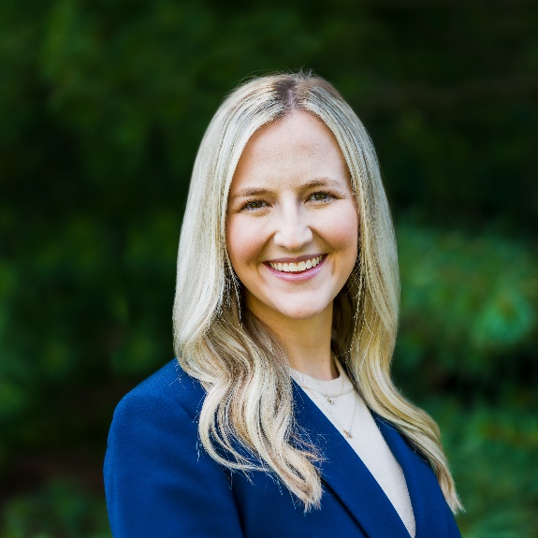
Meet Your
Resource Center Project Director
Caroline McKinney, MS, RDN, LD, CNSC
  Nutrition Innovation Director
  Grantee Technical Assistance
    Monthly meetings and agendas
    Listserv
    Yearly in-person grantee conference
    Monthly Grantee Gatherings
  caroline.mckinney@iowa.gov
Notes:
Caroline
Thank you so much for having me today. I am very excited to get to know each of you and your projects and work together moving forward. Nutrition Innovation Director at NRCNA. Started in December. Registered RD. Prior to joining the NARC, I most recently came from a clinical/ICU background.
The Resource Center will serve as your go-to hub for innovative ideas and best practices for the network. A large part of this is being a support system for the grantees. You will receive emails and information shortly to begin setting up agenda meetings this fall. Please be thinking about who you would like to attend these monthly meetings. We will be working with Iowa State University to evaluate our work to ensure we are meeting your needs. There may be a request from them throughout the grant period, and we appreciate your feedback.
We will discuss the technical assistance points in greater detail in the next few slides

Slide 17
Other Key Staff…
Alex Bauman, RD, LDN
  NRCNA Director, Division Director, Nutrition & Wellness, Iowa Department on Aging
Erin Hoisington, RDN, LDN
  RDN, LDN, Nutrition and Aging Content Director
Bambi Press, RD, LD
  Healthy Aging Director
Marissa Vance, MAC
  Communications Manager
Denita De Raad, CAFS
  Nutrition and Wellness Division Administrative Assistant
Notes:
Caroline
From time to time, grantees do interact with other staff members of the NRCNA. I’d like to take a moment and acquaint you with our staff members.
As I mentioned, at any point in time, you could receive a request from one of our staff members. You will enjoy your interactions with our team.

Slide 18
Nutrition Program Network: Enhanced Programming
“Quickinars” and short courses
“Lightening Talks” with grantees
Best Practices guides with validated tools
Live webinars and recordings with Spanish translations and subject matter experts
Printable materials
Leadership and Advocacy
Notes:
Caroline
You will see enhanced programming from the NRCNA including:
“Quickinars” and short Courses, designed to quickly inform the network on topics like OAA basics and innovations
“Lightening Talks” with former and current INNU grantees which showcase work to the network
Best practice guides that contain validated tools.
Live webinars with subject matter experts on key topics like hospitality, gerontology, DEI and food systems from Iowa State University
Printable materials
Leadership and advocacy at the local, state, and national level. We will attend and present at conferences

Slide 19
INNU Grantee Assistance
Monthly meetings – detailed agenda
Listserv
Annual grantee meeting
Monthly grantee gatherings
Technical assistance (best practices, solutions to barriers, resources etc)
Notes:
Caroline
At your first monthly meeting, in September we’ll walk you through how to complete the detailed agenda, which is sent to both the Resource Center and your ACL Project officer at least 3 business days in advance of your monthly meeting.
**Also, your financial department may have questions related to PMS or financial reports. If so, please let us know and we can do our best to arrange for Mr. Lewis to attend the meeting during that portion of the discussion.**
There are a large variety of tools to provide you with assistance. You and your team are invited to join our grantee listserv or fondly referred to as the INNU Grantee Listserv. This is a space for former and current innovations in nutrition programs and services grantees to seek input or best practice recommendations from other grantees, ask clarifying questions regarding grant work, foster networking opportunities, share successes or challenges incurred within the grant period and to share research and resources. If you would like to join the INNU Grantee Listserv or remove yourself from the INNU Grantee Listserv at anytime, please email myself with your first name, last name and email.
The INNU Grantee Annual Conference is a chance for all grantees to come together and will be a great opportunity to meet others, listen to keynote sessions, network and brainstorm, and have a videographer document our work.
Monthly grantee gatherings are optional webinar gatherings and were created as a result of grantee requests to network, share resources and provide mutual support as their grant progresses and we were happy to facilitate! Topic area and discussion points are emailed each month prior to the call.
Technical assistance is provided from myself and our team at the NRCNA and we have access to knowledge from ISU and others to help problem solve.

Slide 20
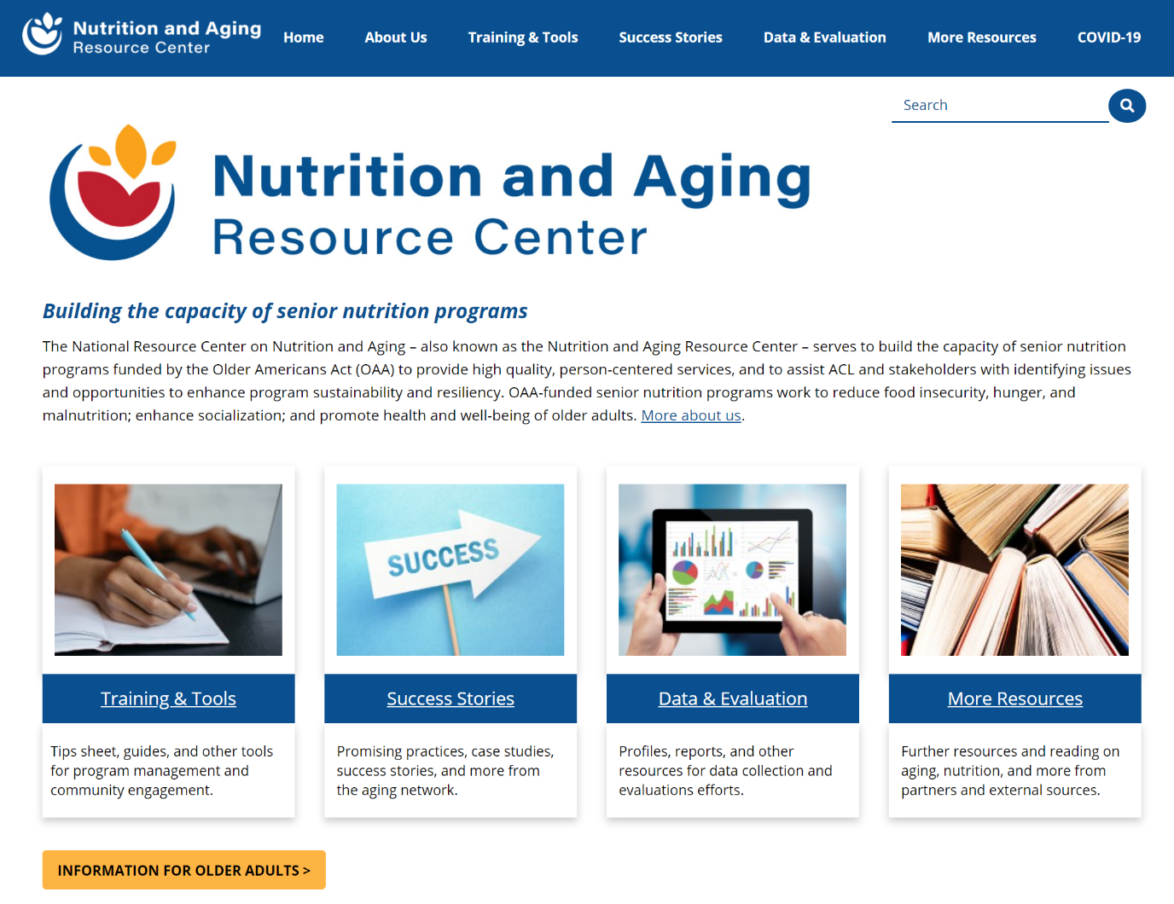


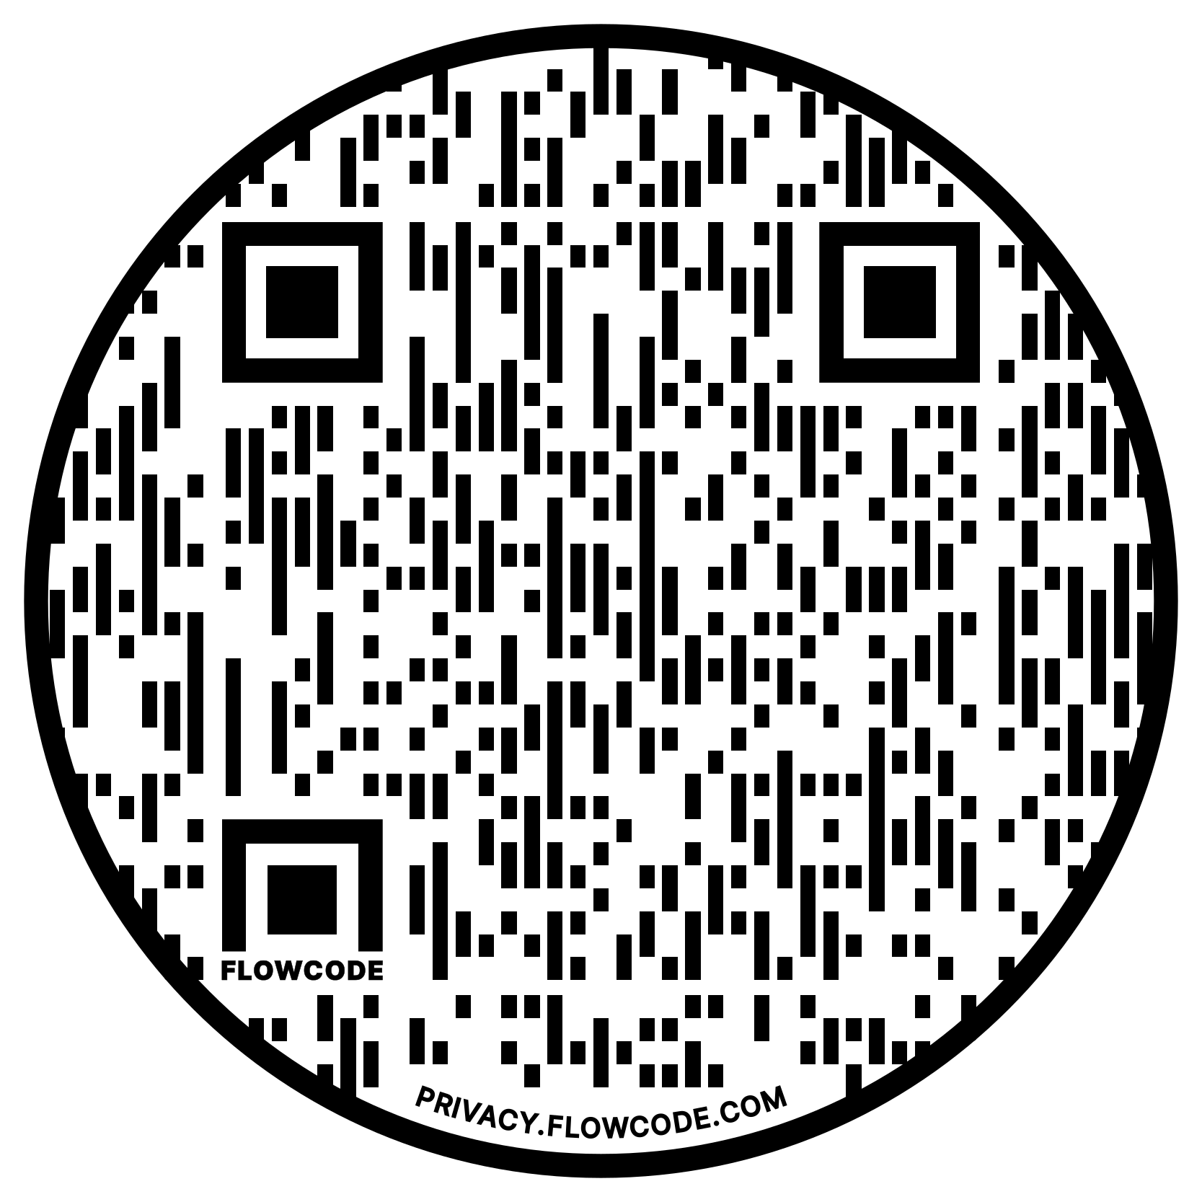
Nutrition and Aging Website
acl.gov/senior-nutrition
@AgingNutrition
Notes:
Caroline
I want to take this opportunity to make you aware of our new Nutrition and Aging Website. This website holds a host of information and resources. Examples include: tip sheets and trainings, previous grantee models, data and evaluation information, resources for older adults and links. I do want to note that our website is currently under redesign and will be organized into user and search friendly categories once completed.
I encourage you to visit the website and familiarize yourself with the resources available, should you need them. And, please know that new materials will be posted regularly!
We are also on a host of social media—follow us and engage with us @…
If you scan this QR code it will take you to a webpage that links to all of our social media accounts-so also feel free to do that!

Slide 21
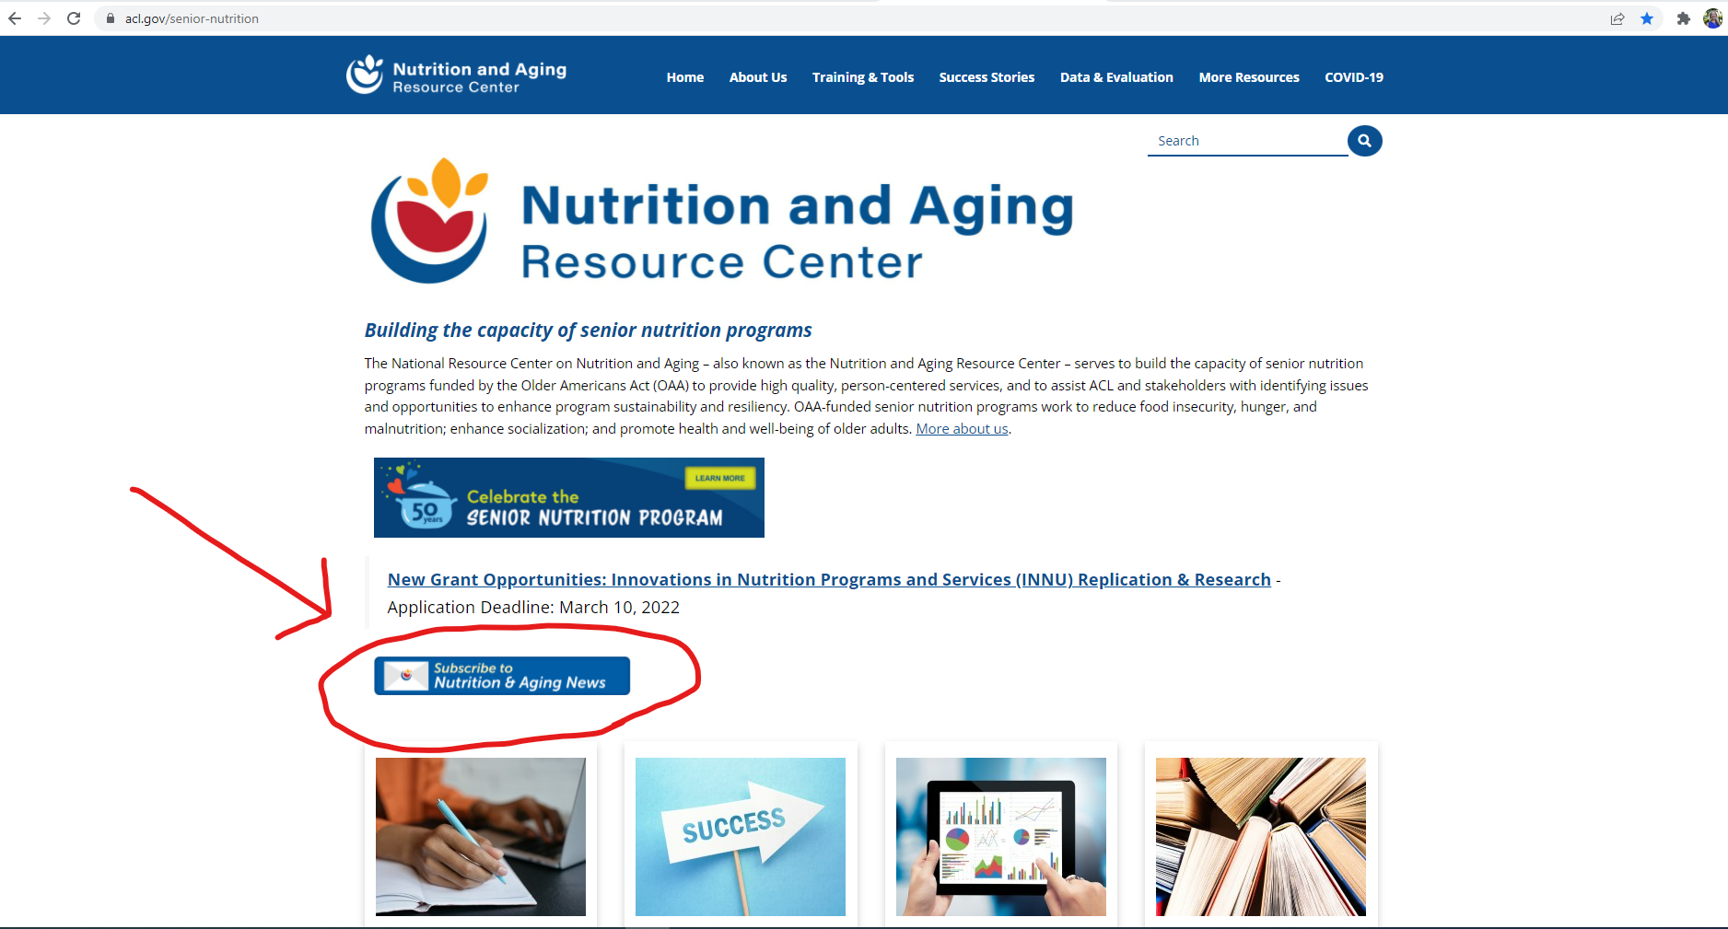
Nutrition and Aging Newsletter
Notes:
Caroline
Finally, I recommend you subscribe to our monthly newsletter-
Very practical information to stay up to date on happenings in the SNP.
I’ll turn the presentation back to Judy at this time….

Slide 22
Reporting Calendars
  Lists the due dates for both programmatic and financial reports
  Lists the due dates for other reports such as the Capstone Report (Research grants only)
  Gives information on how and where to upload reports.
Notes:
Judy-
Now let’s move to reporting by grantees.
You will all receive a Reporting Calendar that gives you the dates of when your programmatic and financial reports are due. Research grants cover five years and include a Capstone Report. Replication grants are for three years and do not require a Capstone Report. Information is also included on how and where to upload your reports.

Slide 23
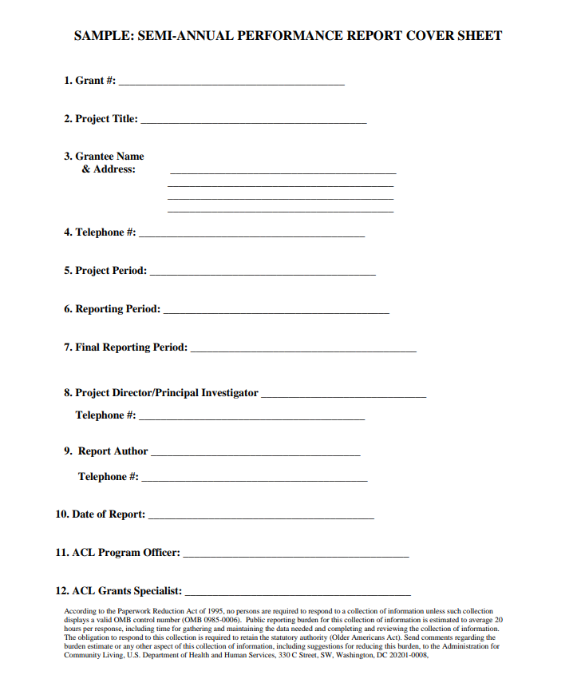
ACL Semi-Annual Progress Report
Semi-annual due:
  -Due 30 days after each 6-month reporting period
Upload in GrantSolutions
Email to your TA Liaison and ACL Project Officer
Current Guidelines for Preparing Performance Reports for Grants
Notes:
JUDY
Deliverables required by all ACL grantees include the programmatic semi-annual and Final Reports. These reports are a communication tool and should be clearly written and understandable for a wide range of readers. Performance Reports should document project findings, outcomes, activities, methods, lessons learned, and products of significance to the fields of aging and disability.
Each semi-annual report is reviewed thoroughly by ACL project officers, who in turn generate a Monitoring report which is part of your grant’s permanent record.
Just some notes about the semi-annual progress report-
They are due 30 days after each 6-month reporting period
Understand there is a monitoring process connected with these reports and the monthly call after you submit the semi-annual report is considered a monitoring review call where the report will be discussed and the ACL project officer will inquire regarding progress on your planned activities, goals and objectives.
You will Upload program reports in GrantSolutions (https://www.grantsolutions.gov) as a grant note
In addition, please Email to your Technical Assistance Liaison and ACL Project Officer
We’ve provided the link to your resource regarding the format of your report, please see Current Guidelines for Preparing Performance Reports for Grants.

Slide 24
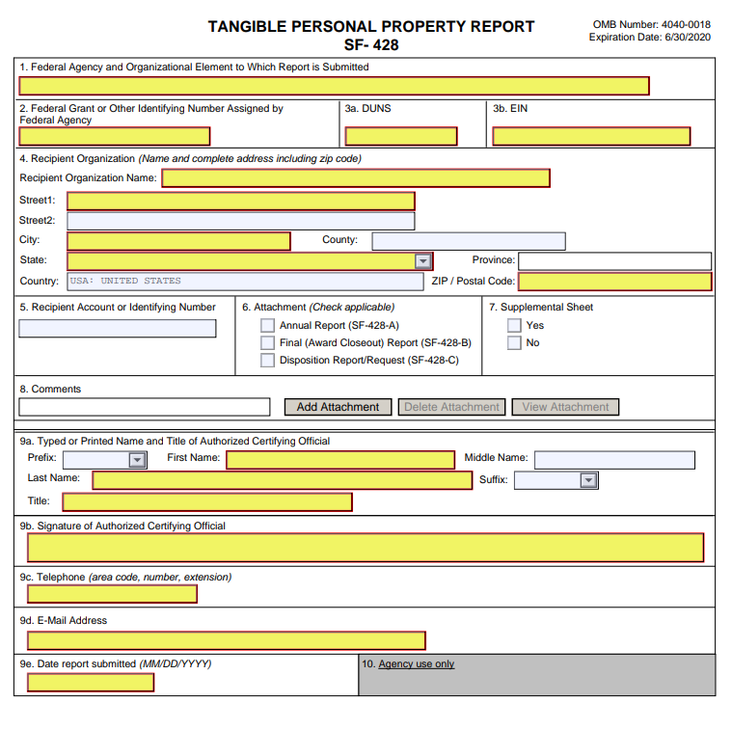
Final Reports
Final Cumulative Reports (Program and Financial)
Due (within 90 days)
  -Research: November 30, 2027
  -Replication: November 30, 2025
Email to Technical Assistance Liaison and ACL Project Officer
Current Guidelines for Preparing Performance Reports for Grants
Notes:
JUDY
You have Final Cumulative Reports (Program and Financial) which will be due 90 days after the end of your project period.
They are due November 30, 2027 for Research projects, and November 30, 2025 for Replication projects.
You’ll see this slide shows one unique report that is only due at the grant closing, which is the tangible property report.
The Final Reports take the place of the Semi-Annual Report and the annual financial reporting at the end of the final year of the grant.
Final program and financial Reports cover the entire 3 or 5 year project period and the final program report follows a different format than the semi-annual reports.
Please also go to the Current Guidelines for Preparing Performance Reports for Grants to identify the format for your final project report.

Slide 25
Financial Reporting and Payments
Annual report (SF425) due August 31
Submit financial reports through PMS
Financial Reporting Instructions
PMS is also the system for requesting payments
Notes:
JUDY or SEAN
The SF 425 annual report is due August 31, 30 days after the end of each budget period for grants. Final financial reports are due 90 days after the end of the project period.
You will submit financial reports through PMS.
For financial reporting instructions I’ve included a helpful link: https://pms.psc.gov/

Slide 26
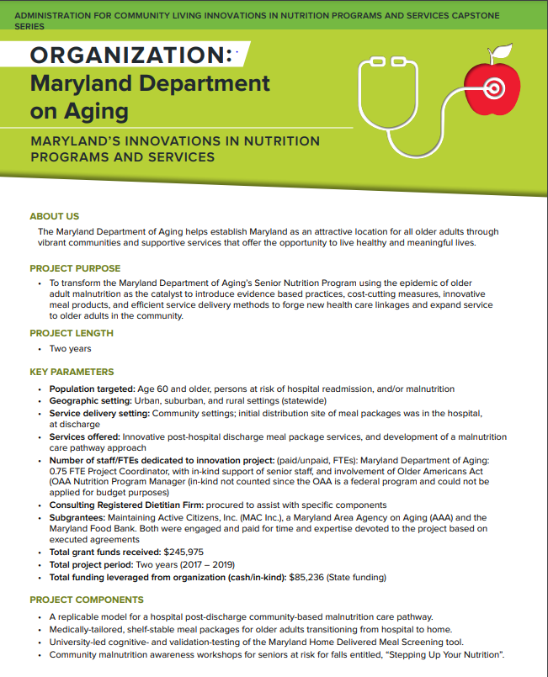
Capstone Project
Due:
  Research: October 31, 2027
  Replication: No project due.
Combines replication tools, lessons learned, and other materials
https://acl.gov/senior-nutrition/models
Notes:
JUDY
The Capstone Report will be due October 31, 2027 for Research projects. No Capstone Report is due for Replication grants.
The report combines the replication tools, lessons learned, and other materials created by grantees. Specific format and requirements for the capstone project will be provided throughout your grant project period.
We’ve provided a link to past Capstone reports and encourage you to check them out, so you have a good understanding of expectations.

Slide 27
Who to Call?
Judy Simon
Initial contact
Sean Lewis
Financials
NRCNA
Technical Assistance
Monthly Calls
Peer Engagement
Listserv
Annual grantee meeting
SF-425
Programmatic Reports
Work plan revisions
Amendments
Notice of Award (continuations)
Required reporting calendar
Notes:
JUDY
Sometimes confusion can exist around who to call. So, I’ve included a visual that provides a quick look see around who to call for what. Keep this handy so you can refer back to it, as needed.
In general, I will be your first ACL contact if the question is about grant-related requirements. Carolyn and the resource center will be your contact for monthly calls, technical assistance, the listserv and opportunities to engage with your peer grantees.

Slide 28
GrantSolutions and
Payment Management System
Grant Solutions
  Program and financial reporting
  Managing an ACL Grant
  New User Sign-Up
Payment Management System (PMS)
  Payments for grantees
  New User Request
Notes:
JUDY
As a grantee, you’ll use the GrantSolutions and Payment Management System websites. I’ve provided the links to these website on this slide.
Specifically, all program and financial reports should be submitted via Grant Solutions Website. Be sure key staff who will upload reports have accounts under GrantSolutions. If you need assistance, contact GrantSolutions.
Resources are available on the ACL website to assist with requesting GrantSolutions issues also, for example requesting changes to your project staff, and how to upload reports - at Managing an ACL Grant Website
And finally, payments for grantees are made through the Payment Management System (PMS). PMS is administered by the Program Support Center, within the Division of Payment Management.
ACL staff do not manage GrantSolutions or PMS. You will need to work with the respective helpdesks should you have any questions or require assistance.

Slide 29
Help Desks
GrantSolutions Help Desk
  Support available: Monday through Friday 7am - 8pm ET (closed Federal holidays).
  Phone: 1.866.577.0771 or 202.401.5282
  Email: help@grantsolutions.gov
PMS Help Desk
  Support available: Monday – Friday from 7 am - 9pm ET (closed Federal holidays ).
  Phone: 1-877-614-5533
  Email: PMSSupport@psc.hhs.gov
  FAQs: Self-Help Portal
Notes:
JUDY
If you need additional help, the GrantSolutions help desk is available for assistance on all GrantSolutions products and services. As you’ll see, we’ve included details on timing, contact numbers and email.
There is also a PMS Help Desk to assist all system users. The phone number, email address and a link for Frequently Asked Questions is also included in this page.
Please keep this information close at hand so you can access easily.

Slide 30
Next Steps
Monthly grantee meeting invitation
Verify GrantSolutions and PMS access
Monthly grantee gathering invitations
Join the Listserv. Once subscribed email INNU_GRANTEES@LIST.NIH.GOV
Grantee Product Disclaimer https://acl.gov/grants/managing-grant
Begin project work
Notes:
JUDY
To finish up today’s presentation, I’m going to give you a little bit of “homework” from our web call today. Your next steps include the following:
First, the National Resource Center will be communicating with you to schedule your monthly call date and time. Please make sure these are on your calendar and you let the Resource Center know who should be invited, including their specific email addresses..
Next, you should verify GrantSolutions and Payment Management System access. Do this as soon as possible since you will be using these two websites extensively as a grantee.
Next, please accept the monthly Grantee Gathering invitations, which you will be receiving shortly.
And, please Join the INNU listserv. You will let the Resource Center know who you want subscribed when they reach out to you after this meeting.
This is an email discussion list for INNU Grantees and sponsored by the National Resource Center on Nutrition and Aging (NRCNA) and ACL. We hope this list will be an effective channel for you to solicit the advice of your peers, benefit from their experience and participate in an ongoing conversation. This email discussion list is an opportunity to network, ask questions, seek advice and share resources and best practices with others who have INNU grants.
In addition, ACL and NRCNA may utilize this listserv to distribute newsletters, issue announcements, and provide technical assistance.
Once you are subscribed, To post a message to all the list members, send an email to INNU_GRANTEES@LIST.NIH.GOV. Other instructions will also be provided when you subscribe. Many grantees only have one or two staff who are members of the listserv, and those individuals share any pertinent information with others, as appropriate.
And, just a reminder - all ACL discretionary grantee products MUST include the ACL-required disclaimer on the first page or preface of all documents and webpages produced, all or in part, with ACL funding. We’ve shared a link to the specific required language on this slide.
Lastly, Begin project work per work plan. Get started as soon as possible. There is a lot of work to do organizationally in the first year and it is best to get a jump start on it.

Slide 31

Questions?
Photo by Brett Jordan on Unsplash
Notes:
We’ve covered a lot of information on our call today. I’d like to open our webinar up for questions. Please feel free to put a question in the chat box or feel free to jump in now and ask it.

Slide 32
National Resource Center for Nutrition and Aging
Visit the site today!
THANK YOU!
Notes:
This concludes our presentation. I hope you’ve enjoyed learning about ACL and the INNU grantee process and expectations. Again, we are so thrilled you are part of the 2022 INNU grantee cohort. Thank you for your time and attention.

