Slide 1
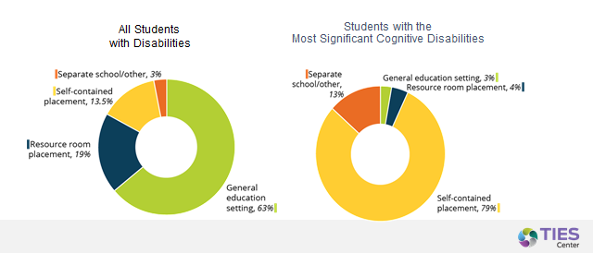
Inclusive Education
Notes:
An area we have not explored enough is the reality that the overwhelming majority of children with the most significant disabilities are not experiencing inclusion in schools, community living is about learning too and these children need to be included.

Slide 2
National Core Indictors™ 2017-18
N=24389, data comes from state records
Notes:
As I said, states certainly vary and they are a significant predicter of outcomes. If you look across states there is variation in the percentage of people with IDD who have legal guardians, this number ranges from 5.5% to 89%. In some states, it is almost an automatic process that when a child turns 18 they have a legal guardian. Yet, we know people with all disabilities, including intellectual and developmental disabilities, have rights and are perfectly capable of making decisions about their own lives. Our efforts to embed in systems of education, law and disability services, knowledge about and policies that promote supported decision making will be critical.
_____________________
81% family member
3% friend
11.3% public guardian
2.2% non profit
1.2% financial institution

Slide 3

Workforce Key to Quality (and person centeredness!!)
Notes:
Perhaps the greatest challenge we face, and one that there has been virtually no federal policy to broadly address, and very very little state policy to address, is the workforce of direct support professionals that choose careers in supporting people with disabilities. We have built a community system on the backs and out of the pocketbooks of these workers.

Slide 4

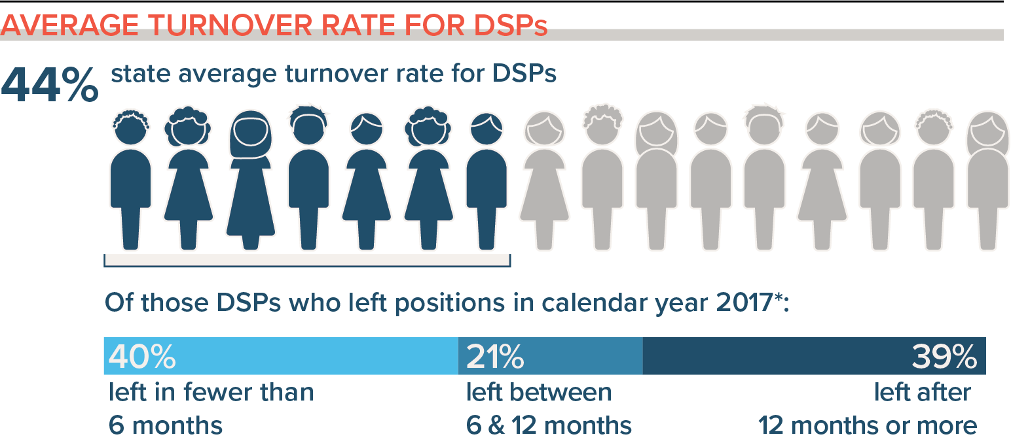
DSP Average Turnover Rate
NOTE: CO Alliance Survey 2016 was 37.8%
National Core Indicators. (2019). National Core Indicators 2017 Staff Stability Survey Report. Retrieved from the National Core Indicators website: www.nationalcoreindicators.org/resources/staff-stability-survey/
Notes:
This systemic flaw is that we have sustained turnover rates that approach 50%, vacancy rates that near 20% and….

Slide 5
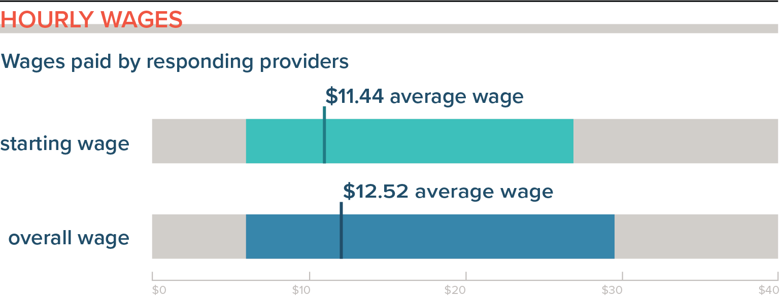
DSP Wages
National Core Indicators. (2019). National Core Indicators 2017 Staff Stability Survey Report. Retrieved from the National Core Indicators website: www.nationalcoreindicators.org/resources/staff-stability-survey/
Notes:
And wages on which no one can make a living let alone support a family. These number have remained the same for the past 25 years and to date, we have no systemic approach to finding and implementing solutions.

Slide 6
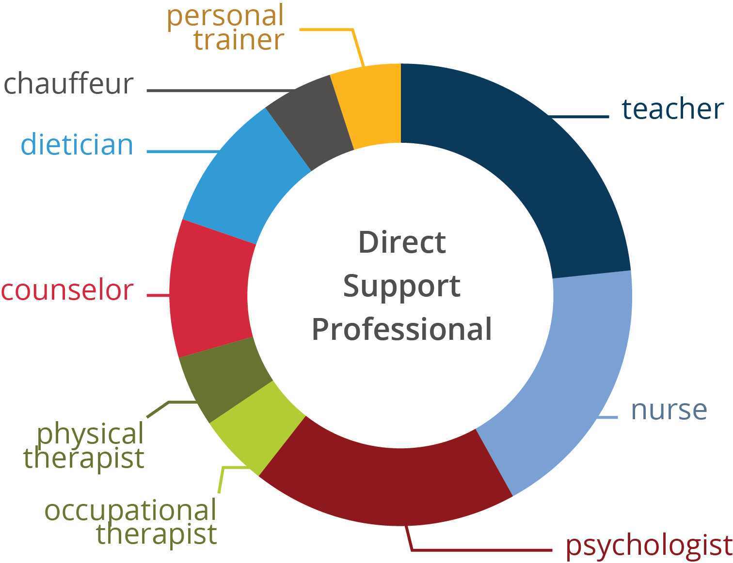
DSP Scope of Practice - Multidisciplinary
Notes:
We know that these direct support workers are multidisciplinary professionals who are not recognized, celebrated or valued by our systems of support or communities for what they do. In order to sustain the promises of Olmstead, we must find solutions to the workforce challenges.

Slide 7
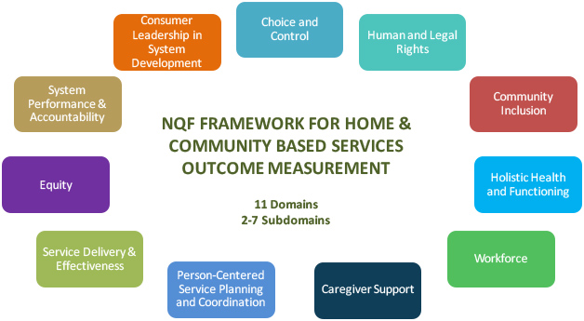
National Quality Forum (NQF) Network
Notes:
Lastly. we also need to continue to improve our ability to measure progress through a person centered lens. Developing effective measures and holding states accountable for the HCBS outcomes identified in the National Quality Forum framework is an important next step toward improved quality.

Slide 8
National Quality Forum (NQF) Framework
NQF Framework for Home and Community Based Services Outcome Measurement (11 Domains, 2-7 Subdomains)
Choice and Control
Human and Legal Rights
Community Inclusion
Holistic Health and Functioning
Workforce
Caregiver Support
Person-Centered Service Planning and Coordination
Service Delivery & Effectiveness
Equity
System Performance & Accountability
Consumer Leadership in System Development
Notes:
Thank you so much for your time this afternoon. Take the time to celebrate our successes since Olmstead and do everything you can as we move forward to make much needed improvements in our successes to date.

Slide 9
Other Information
Amy Hewitt
Research and Training Center on Community Living
Institute on Community Integration (UCEDD)
University of Minnesota, Twin Cities
214 Pattee Hall, 150 Pillsbury Drive SE
Minneapolis, MN 55455
612.625.1098
hewit005@umn.edu
This research was supported by grant from the National Institute on Disabilities and Rehabilitation Research, U.S. Department of Education #H133G080029 and #H133B080005. Grantees undertaking projects under government sponsorship are encouraged to express freely their findings and conclusions. Points of view or opinions do not, therefore necessarily represent official NIDRR policy.

Slide 10



Thank You

