Slide 1
Examining Choice: NCI-AD
(aging and disability)
~70% can choose/change the kind of services they get (range ~55%-80%)
~65% can choose how often/when they get services (~45%-80%)
~40% can choose roommate (range ~20%-70%)
~95% can choose when get up and go to bed (~80%-100%)
~80% can choose when eat meals (range ~70%-95%)
Source: NCI-AD
Notes:
For people with physical disabilities and people who are receiving long term services and supports due to aging, 70% can choose or change the services they get, 65% choose the type of services they receive, 40% choose a roommate, 95% determine when they get up and 80% can choose when to eat meals.
___________________
16-17 data, 12 states (CO, IN, KS, ME, MN, MS, NV, NJ, OH, OR, PA, TN)

Slide 2
Examining Transportation:
NCI-AD (aging and disability)
~90% have transportation to get to medical appointments (range ~85%-almost 100%)
~70% have transportation when they want to do things (range ~60%-80%)
Notes:
Additionally, 90% have transportation to get to medical appointments and 70% to get to places they want to go.
I certainly expect that none of these outcomes were present for Lois and Elaine when they were living in an institution.

Slide 3
Opportunities moving forward
Employment outcomes. Supported decision-making. Inclusion in schools. Person and Family centered supports.
Notes:
I think the data I just shared shows much progress and much to celebrate. Research consistently shows that people have better lives when they live and work in their communities. While there is much to celebrate, we have much opportunity to continue to make progress as we move forward to the next 20 years post Olmstead.

Slide 4
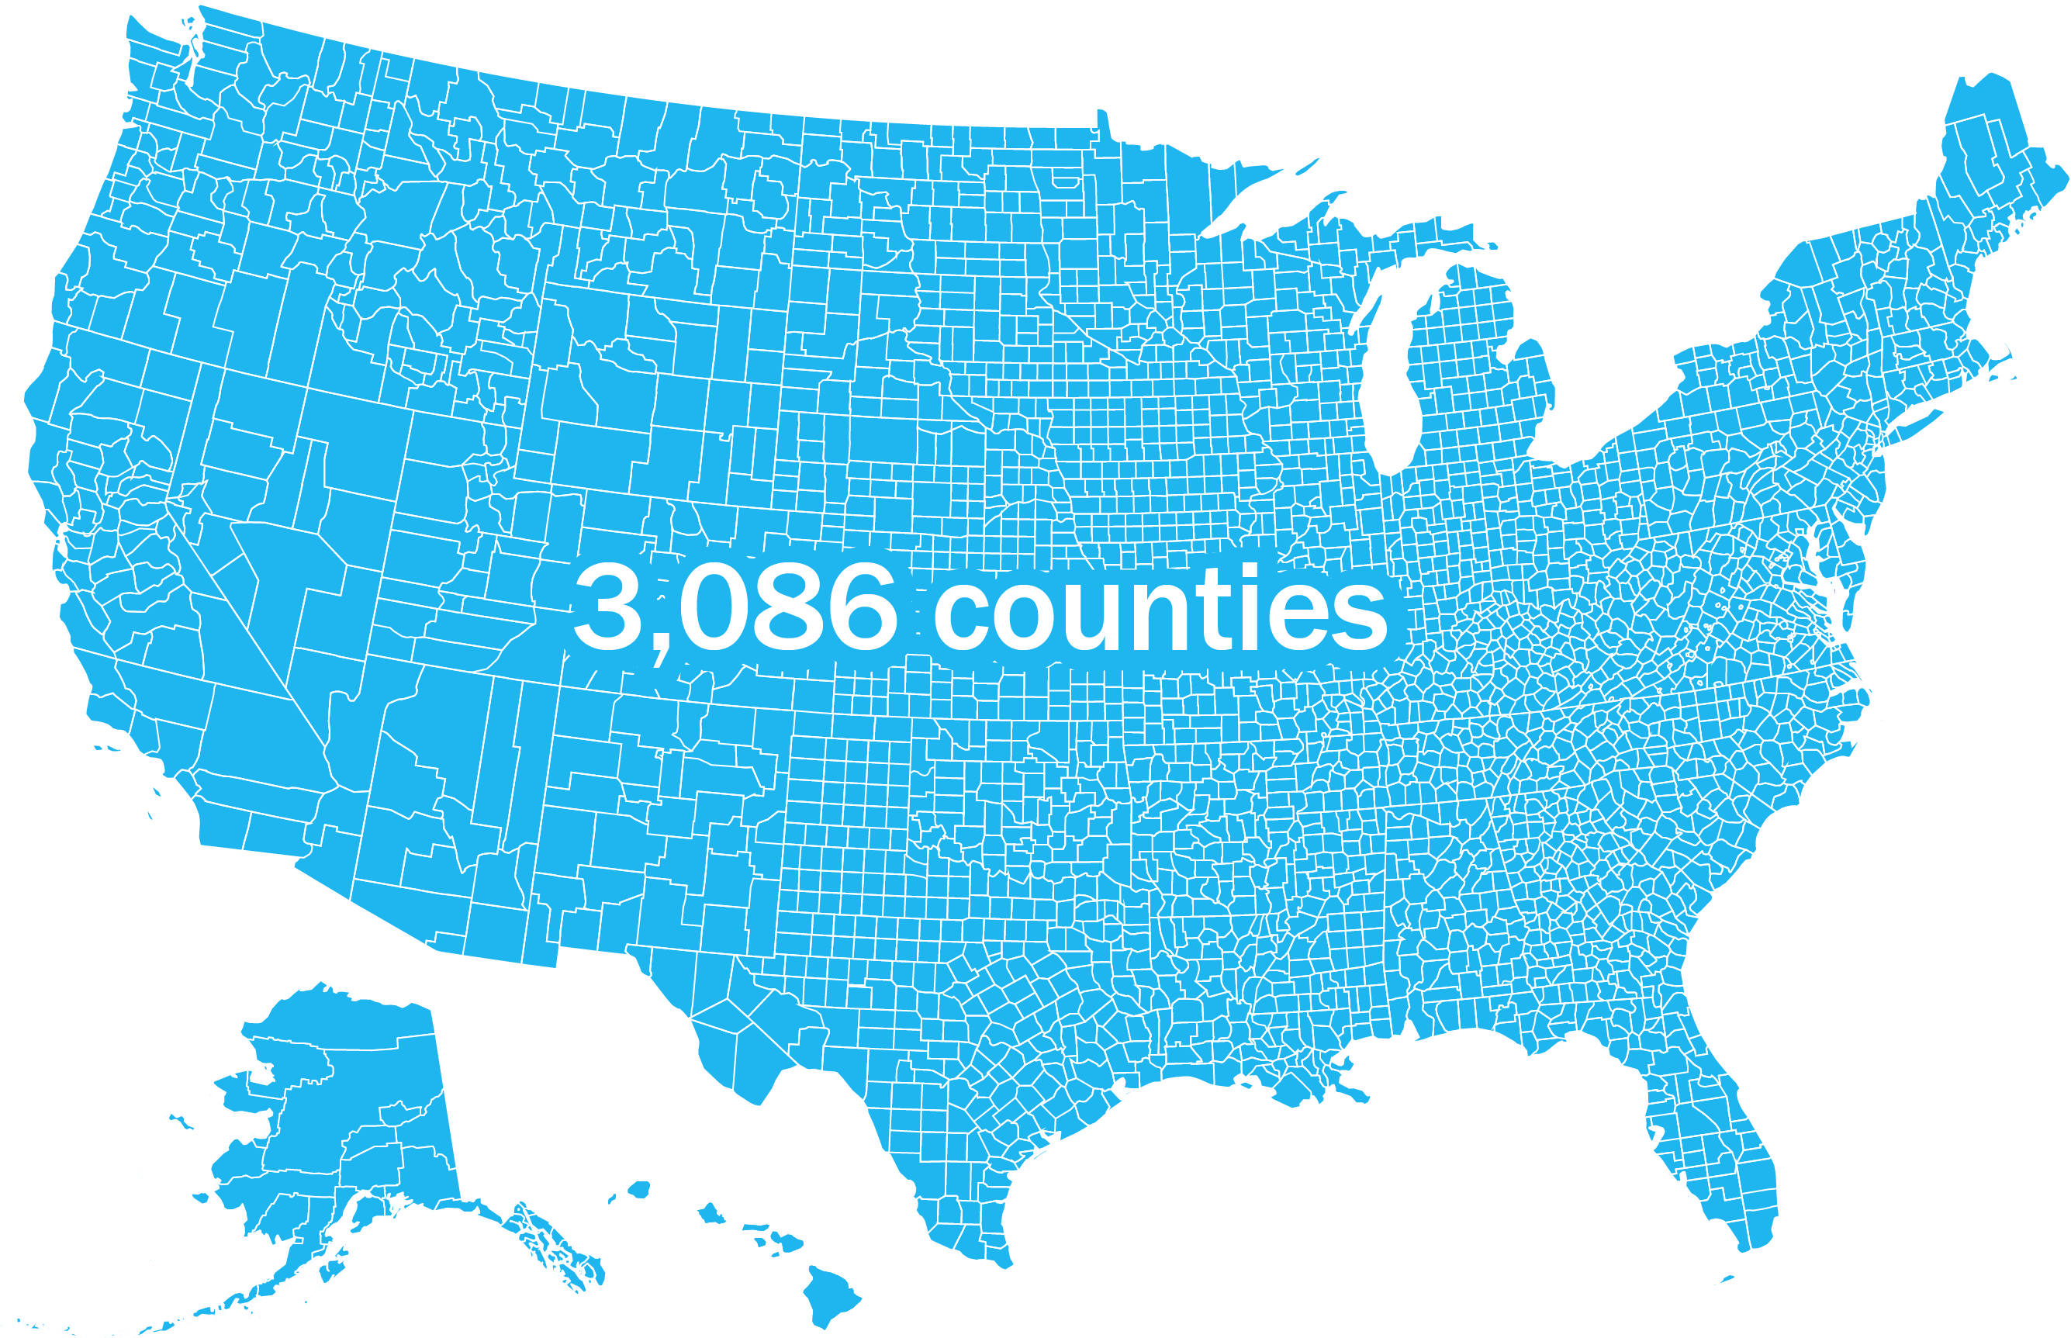
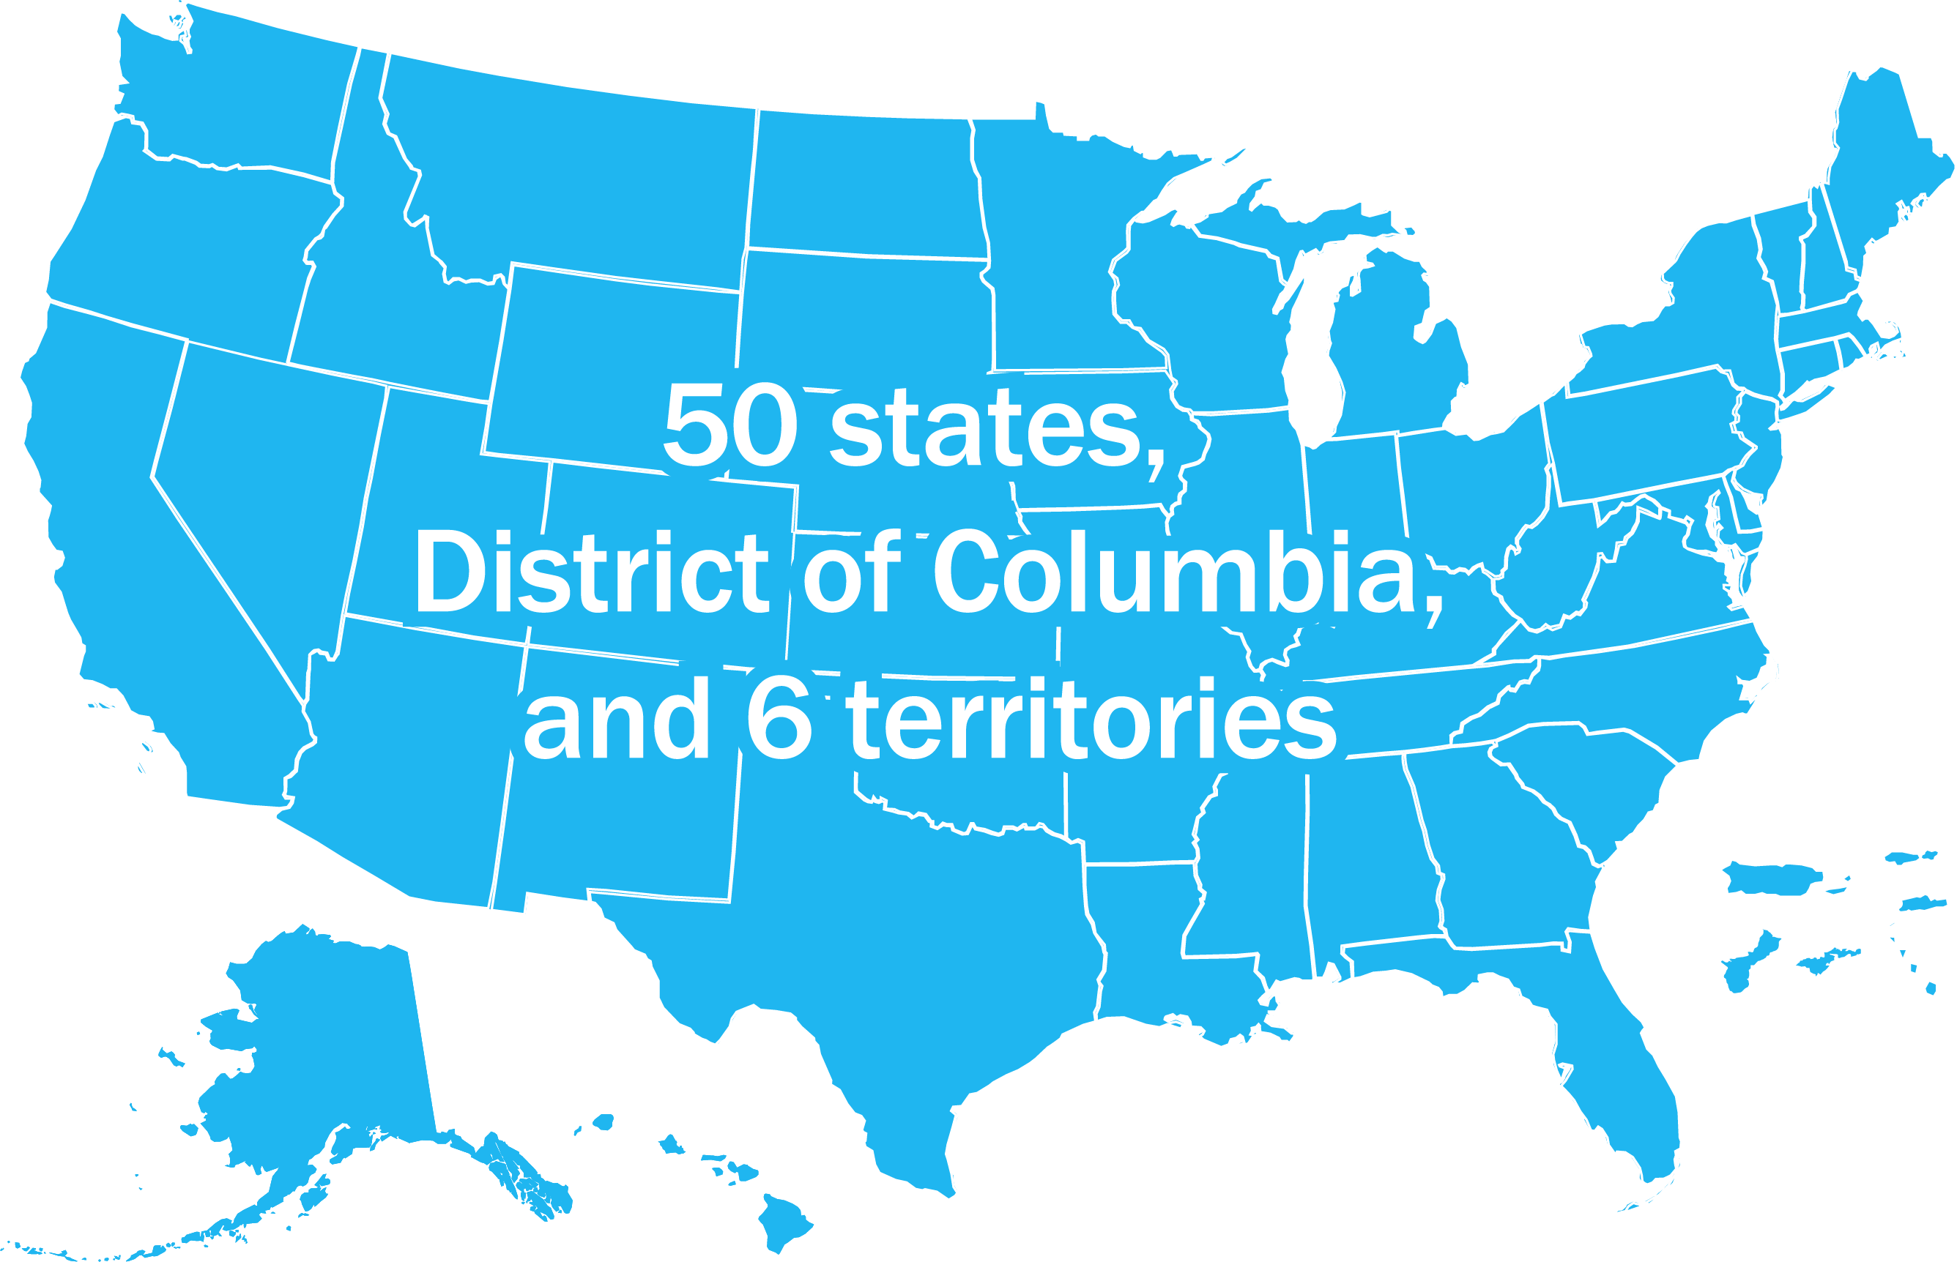
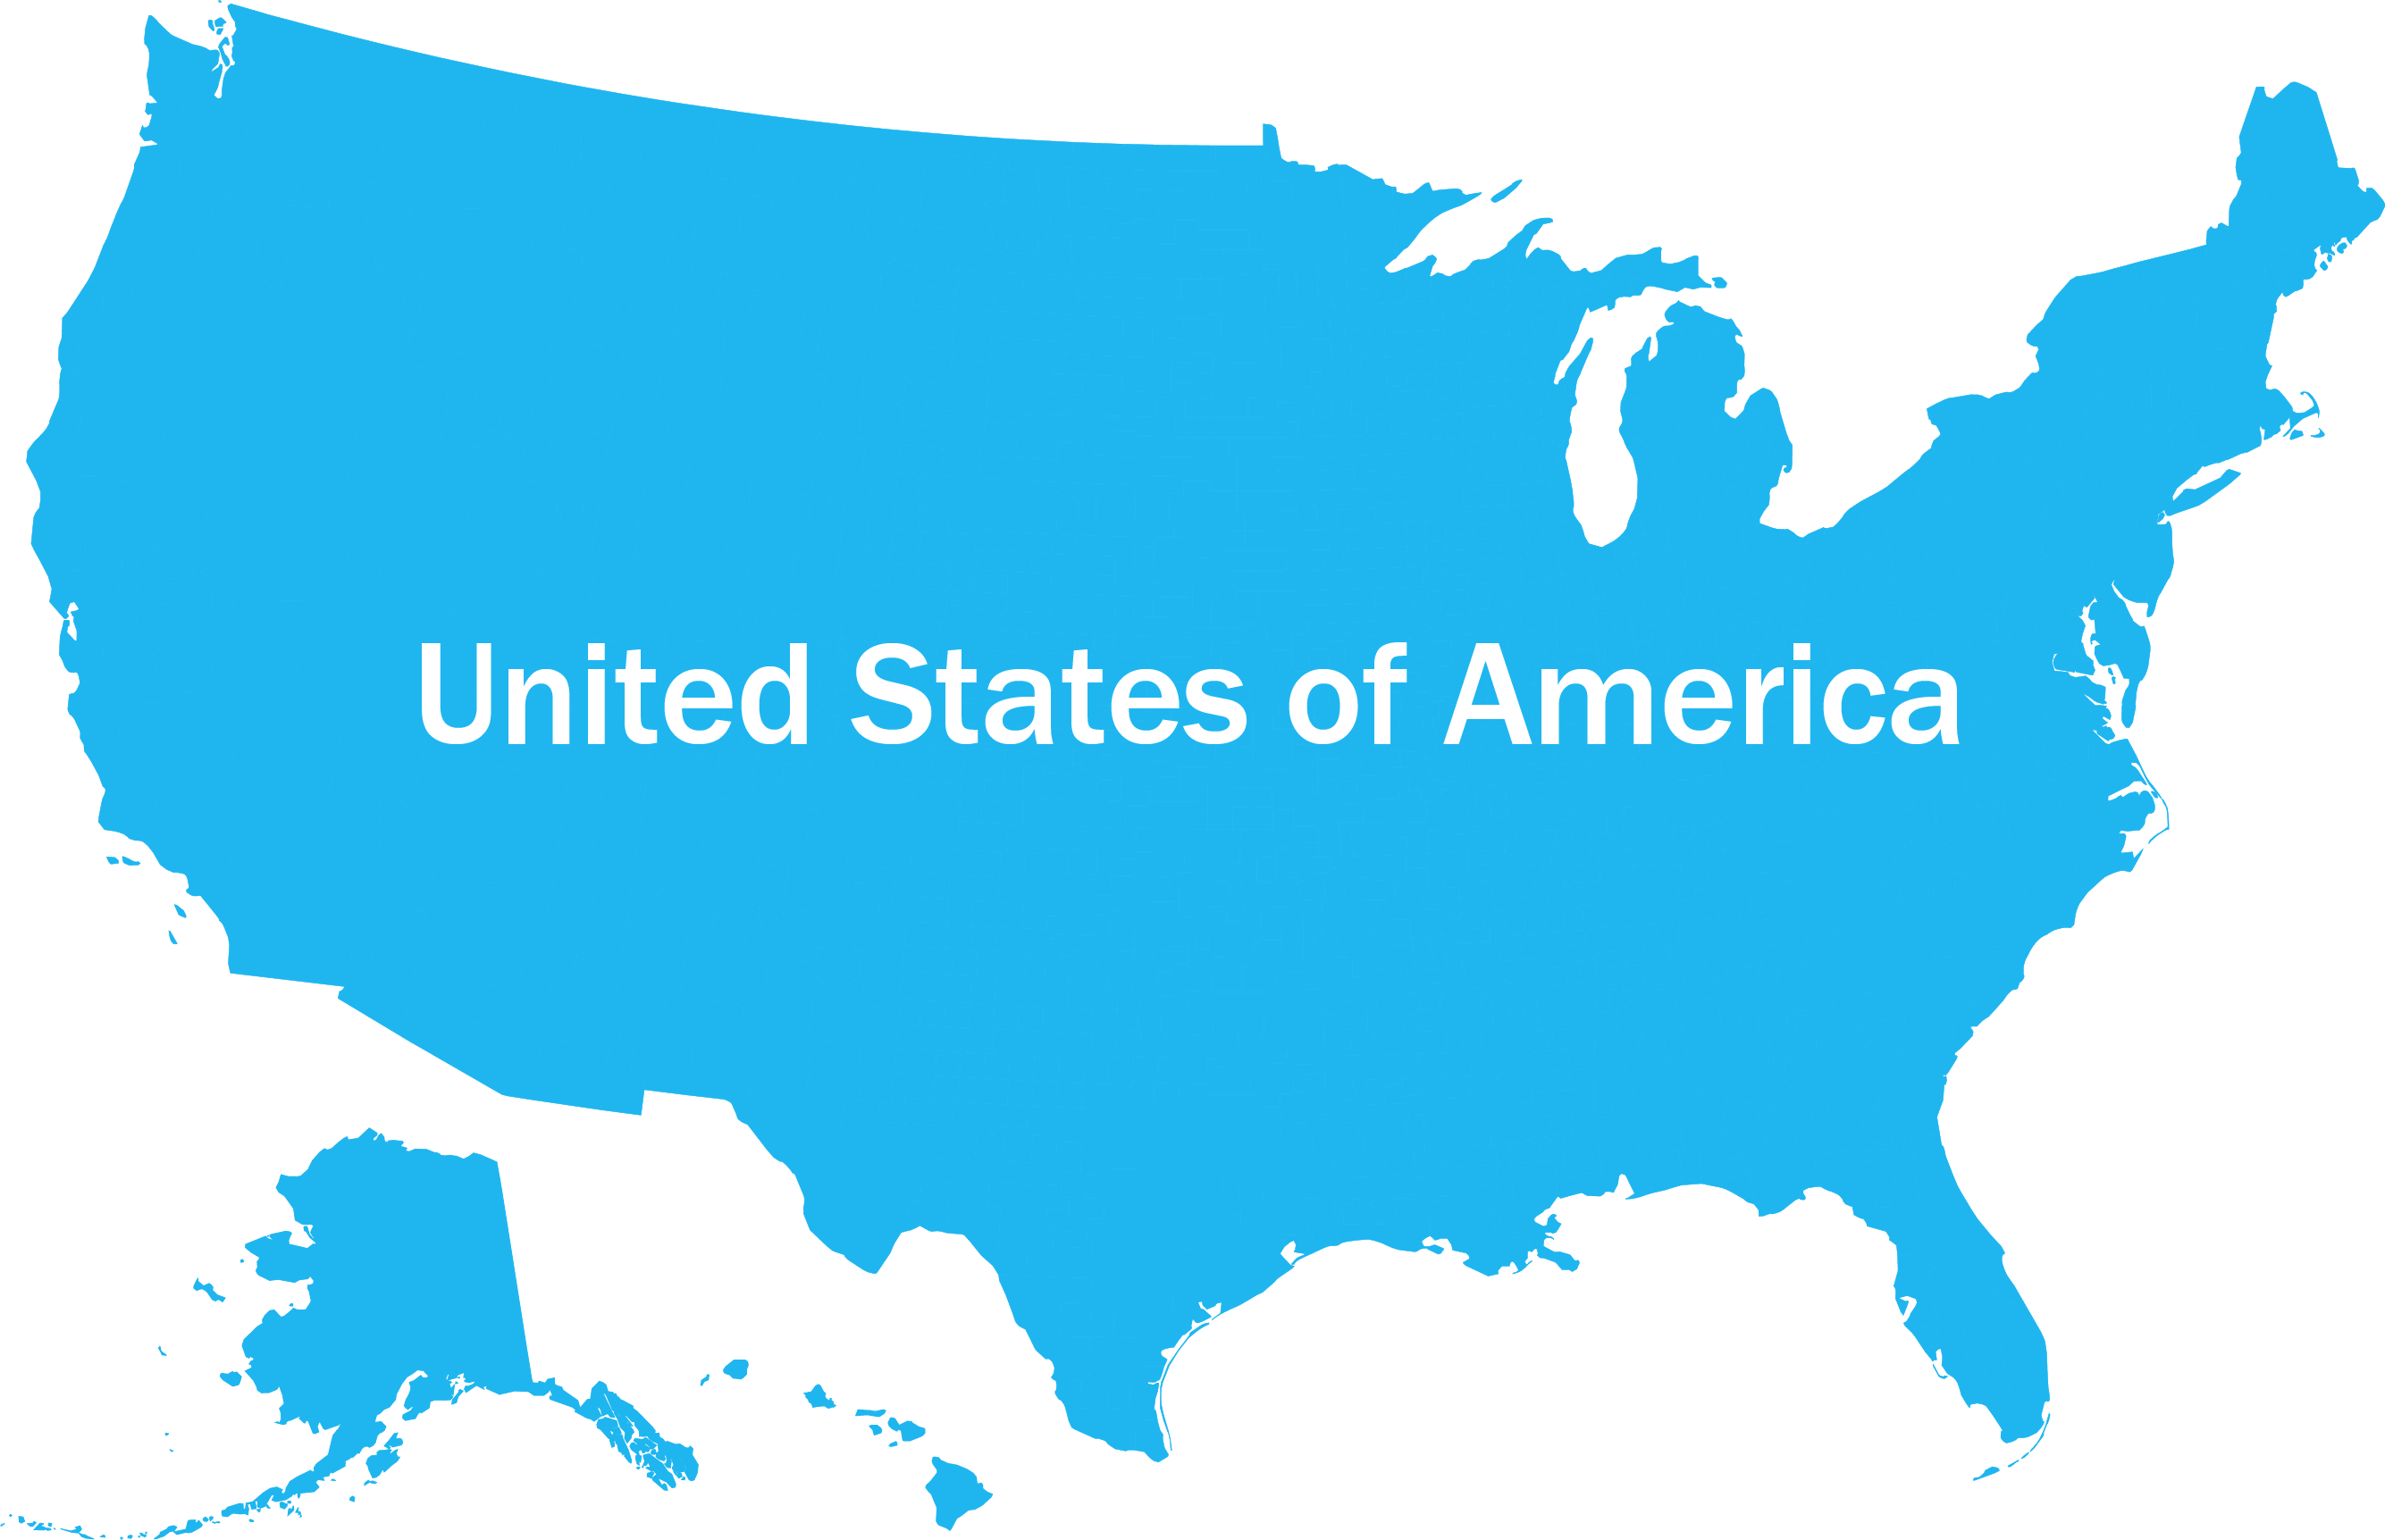
United States of America
Notes:
Perhaps our greatest challenge is disparity based on state. One of the most significant contributors to the ability to achieve individual outcomes and community living and participation is that in the United States we have 50 states, the District of Columbia, and 5 territories. We also have 3,069 counties.
Time and again in the studies that we have done at the Research and Training Center on Community Living, the single biggest predictor of availability, access and outcomes of services or interventions is geography. The state, county and city in which a person lives has a significant influence on the type and quality of services they receive. Local and state control are predominant; as you know, rarely in the U.S. do we ever have a federal law or federal policies that mandate things happen in the same way across the U.S.
Where one lives matters, A LOT!
Our challenge is to ensure community living and participation is available to everyone who wants it in every state and every part of a state.

Slide 5

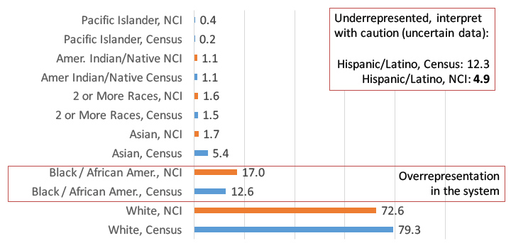
Proportion of People Age 18 and Over Served by State IDD Agencies in NCI States Compared to the Census Population in the Same States. 2016/17.
38 NCI states: Alabama, Arkansas, Connecticut, Delaware, District of Columbia, Florida, Georgia, Hawaii, Idaho, Illinois, Indiana, Kansas, Kentucky, Louisiana, Maine, Michigan, Minnesota, Mississippi, Missouri, Nebraska, Nevada, New Hampshire, New Jersey, New York, North Carolina, Ohio, Oklahoma, Oregon, Pennsylvania, Rhode Island, South Dakota, Tennessee, Texas, Utah, Vermont, Virginia, Wisconsin, Wyoming
Notes:
Another area of disparity that we need to further explore and address is in the area of racial, ethnic and linguistic diversity in the context of community living and participation in the US. In many states, we know that there is an under utilization of HCBS services by some groups and we also know that there is a disproportionate use of more congregate care options by some groups. Making sure that state systems are ensuring that community living and participation is available to, known by and actually used to support lives for individuals with disabilities from diverse communities is a priority.
_______________
Note: we are not sure about the accuracy of the NCI Hispanic/Latino data because we do not know if it was collected in a similar manner as the census. There is also a lot of missing data on the Hispanic/Latino question, so read it with caution
NCI states in 2016/2017 includes 38 states
The state are:
Alabama, Arkansas, Connecticut, Delaware, District of Columbia, Florida, Georgia, Hawaii, Idaho, Illinois, Indiana, Kansas, Kentucky, Louisiana, Maine, Michigan, Minnesota, Mississippi, Missouri, Nebraska, Nevada, New Hampshire, New Jersey, New York, North Carolina, Ohio, Oklahoma, Oregon, Pennsylvania, Rhode Island, South Dakota, Tennessee, Texas, Utah, Vermont, Virginia, Wisconsin, Wyoming

