Slide 1
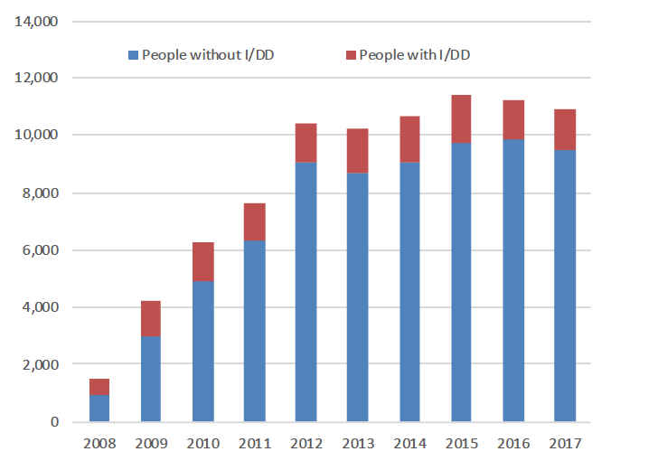
Money Follows the Person Transition
Cumulative Total
  9/07-6/18: 90,000
  I/DD: 14,000
  Non I/DD: 76,000
State Programs
  30 states + DC in 2007
  14 more states in 2011-12
  6 states never participated
  1 (OR) dropped out
Source: Mathmatica, CMS
Source: Steve Kaye, Community
Living Policy Center, 2019
Notes:
Important policies such as Money Follows the Person have resulted in 90,000 people with disabilities transitioning from congregate living situations to community living.

Slide 2
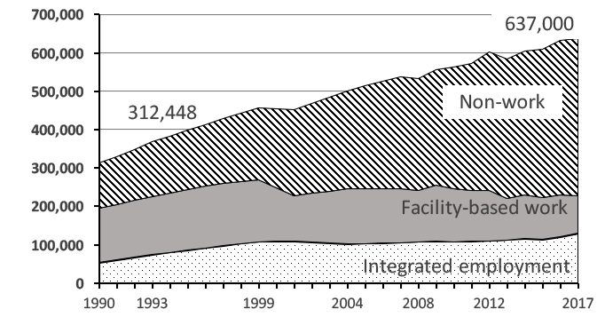
Number in Employment and Day Services
Source: ICI National Survey of State IDD Agencies
Notes:
While not nearly as obvious or quickly, small trends in increased employment for people with intellectual and developmental disabilities to have jobs in the community are beginning to be seen.
_________
Winsor, J., Timmons, J., Butterworth, J., Shepard, J., Landa, C., Smith, F., Domin, D., Migliore, A., Bose, J., & Landim, L. (2017). StateData: The national report on employment services and outcomes. Boston, MA: University of Massachusetts Boston, Institute for Community Inclusion.

Slide 3
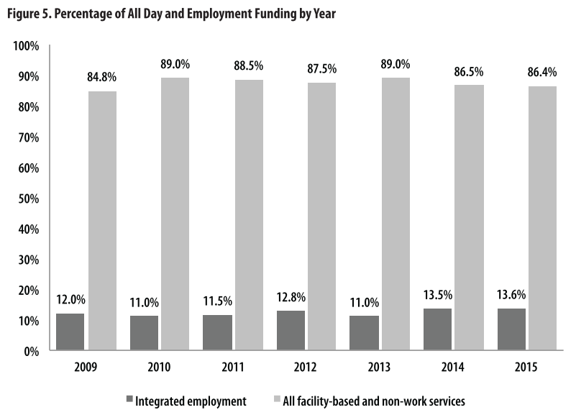
Funding for Employment Services
(IDD agencies)
Source: ICI National Survey of State IDD Agencies
Notes:
These slight changes are being seen despite continued funding imbalances in investments for integrated employment by states.

Slide 4
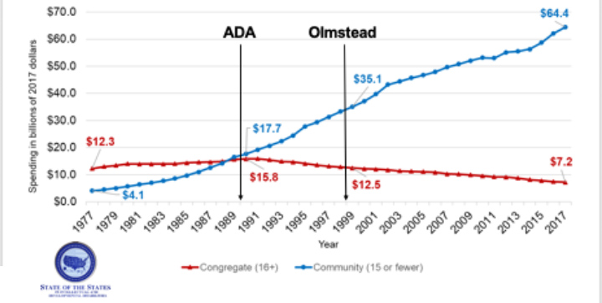
Public Expenditures on IDD Supports and Services in the US: 1977-2014
Source: Tanis, Lulinski, Wu, Braddock, & Hemp (in preparation). Univeristy of CO
Notes:
Without question since the Olmstead Decision we see state systems investing more in community supports and much less in congregate supports.
[pause]
When I think back to Lois and Elaine and wonder what their lives were like inside the institution and then read about their lives once they were freed from the institution, and then I think about what we know about outcomes for people with intellectual, developmental and other disabilities today, I know we have made progress.

Slide 5

Choose Home
The proportion of people who reported they chose or had some input in choosing where they live if not living in the family home
Total respondents Colorado: 189
NCI Average: 11,213
Source: NCI, 2019
Adult Consumer Survey, 2016-17 Final Report
Notes:
Today over half of people with Intellectual and developmental disabilities choose or have input into where they live.
__________
47% had no choice in where they live in the 38 states that participated in NCI
38 NCI states: AL, AR, CO, CT, DE, DC, FL ,GA, HI, ID, IL, IN, KS, KY, LA, ME, MI, MN, MS, MO, NE, NV, NH, NJ, NY, NC, OH, OK, OR, PA. RI, SD, TN, TX, UT, VT, VA, WY

Slide 6
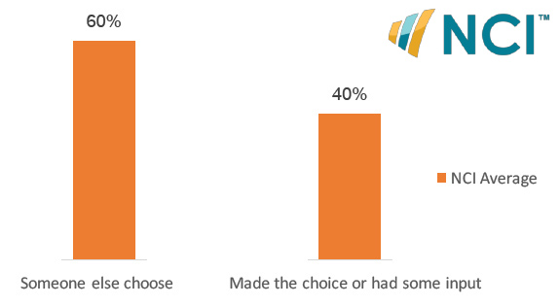
Choose Housemates
The proportion of people who reported they chose or had some input in choosing their housemates if not living in the family home. 2016/17.
Total respondents Colorado: 189
NCI Average: 11,213
Source: Source: NCI, 2019 Adult Consumer Survey,
2016-17 Final Report
Notes:
40% have input into who they have as roommates
________________
53% of people in the 38 states that participated in NCI
had no choice with whom they lived.
Can you imagine that?
38 NCI states: AL, AR, CO, CT, DE, DC, FL ,GA, HI, ID, IL, IN, KS, KY, LA, ME, MI, MN, MS, MO, NE, NV, NH, NJ, NY, NC, OH, OK, OR, PA. RI, SD, TN, TX, UT, VT, VA, WY

Slide 7
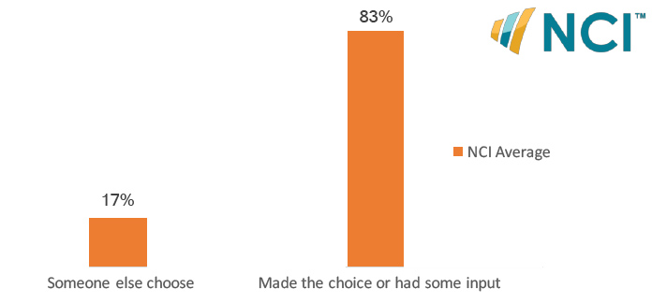
Decides Daily Schedule
The proportion of people who decides or has help deciding their daily schedule. 2016/17.
Total respondents Colorado: 375
NCI Average: 19,420
Source: Source: NCI, 2019 Adult Consumer Survey,
2016-17 Final Report
Notes:
The overwhelming majority choose their daily schedule or have input into it.
____________
For 17% of people in paid supports, someone else chooses their daily schedule

Slide 8
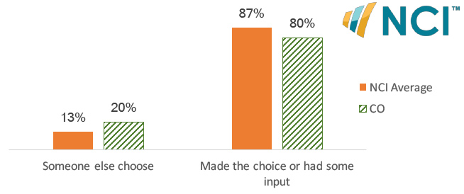
Chooses What to Buy with Their Spending Money
The proportion of people who has help choosing what to buy or has set limits on what to buy with their spending money. 2016/17.
Total respondents Colorado: 397
NCI Average: 19,312
Source: Source: NCI, 2019 Adult Consumer Survey,
2016-17 Final Report
Notes:
And decide or have input into how they spend their money.
___________________
13% in all states reporting have no choice in how they spend their money in reporting states

Slide 9
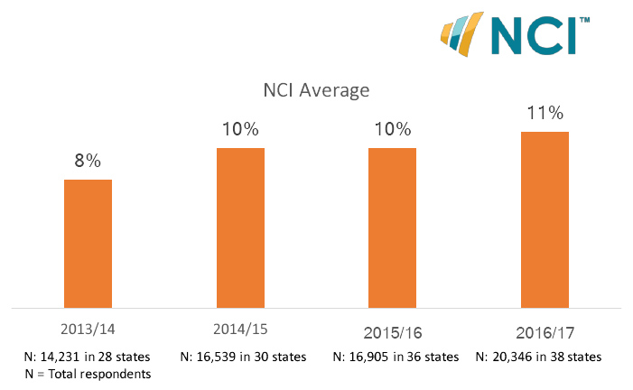
Uses a Self-Directed Support Option
The proportion of people who are currently using a self-direct support option (”Yes” only may be from state options). 2016/17.
Source: NCI, In-Person Survey, Final Results www.nationalcoreindicators.org/resources/reports/
Notes:
Since 2013, roughly 10% of people with IDD self-direct their services.
__________________
Only 11% of people with IDD use self directed support option among all states providing data in 16/17
Note: State data is not reliable for this question since the response requested was only for “Yes” and some data may be missing.

