Slide 1

Smart Innovation for Better Care: AI Solutions to Empower Caregivers
March 2026

Slide 2
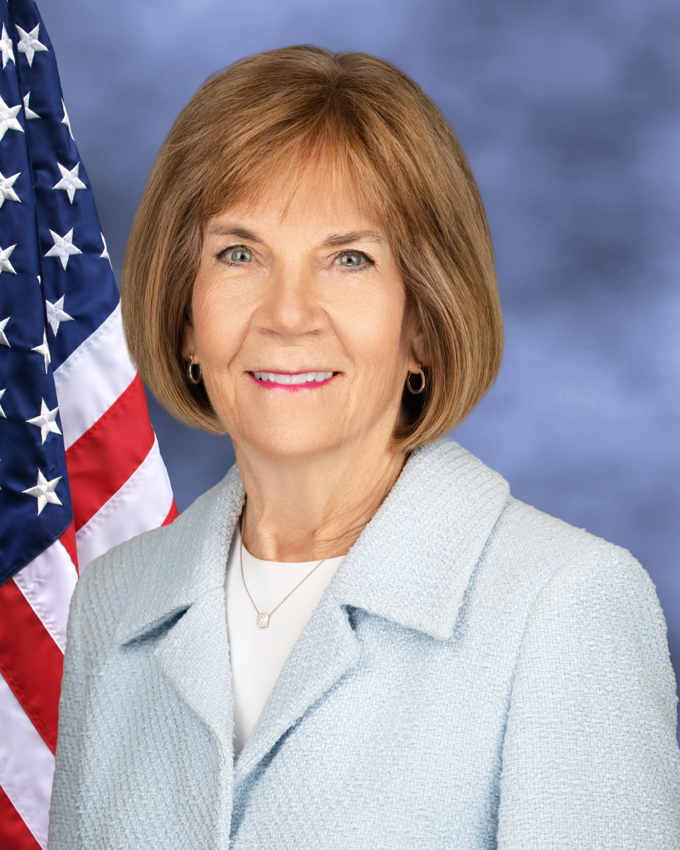
Welcome Remarks
Mary Lazare, Principal Deputy Administrator, serving as the senior official performing the duties of the ACL Administrator and Assistant Secretary for Aging

Slide 3

America’s Growing Care Gap Demands Action
More older adults and people with disabilities are choosing to live in their homes and communities.
Demand for home care is surging, but the caregiver workforce is not keeping pace.
Caregivers, often family members, face significant physical, emotional, and financial strain.
The growing care gap threatens health, safety, and independence, and dignity.
AI is advancing rapidly, yet lacks standards for safe, effective, and privacy-protecting use in caregiving.
By 2032, the US will need an additional 800,000 direct care workers to respond to demand.

Slide 4
Why a Prize Challenge?
A Challenge or Prize Competition is a way for federal agencies to ask for experts and innovators outside of government to develop solutions to a problem. People or teams submit their solutions, and the agency gives prizes to the best ones.
ACL would like to drive innovation and collaboration to support caregivers with user centered, affordable, and accessible AI tools that improve care and reduce burden. We also want to encourage and inform broader adoption of AI tools across home care agencies that extend the direct care workforce.
Federal agencies are allowed to run prize competitions under the America COMPETES Reauthorization Act of 2010. This authority was updated in 2017 through the American Innovation and Competitiveness Act.

Slide 5
Strategic Vision for AI in Caregiving
Goal:
Leverage AI to improve care quality, reduce caregiver burden, and strengthen the caregiving infrastructure for the future.
Ideal AI solutions:
Are affordable, practical, safe, and scalable
Strengthen caregiving in the home and community
Help meet growing demand for care without compromising quality
Supplement, not replace, human connection
Informed by voices and experiences of caregivers
Out of Scope:
Technologies that promote independence but do not directly support caregiving.

Slide 6
How the Challenge Works
Two Tracks, Three Phases
Track One: AI Tools for Caregivers
Track Two: AI Tools for Extending the Caregiver Workforce
Phase 1: Design
Phase 2: Implementation and Testing
Phase 3: Promise of Sustainability
Phase 1: Design
Phase 2: Implementation and Testing
Phase 3: Promise of Sustainability

Slide 7
Caregiver Challenge AI Principles
Protect privacy, dignity, and choice
Support human-in-the-loop accountability
Support caregivers’ well-being and reduce burden
Supplement, not replace, human connection
Allow personalized and flexible care
Promote safety, reliability, and transparency
Ensure affordability and access

Slide 8
Phase 1 Prizes
Phase 1: $2.5 Million will be awarded to winners across both tracks.
​ | Track 1​ AI Tools to Support Caregivers | Track 2​ AI Tools for Extending the Caregiver Workforce
Phase 1: Design​ | Up to 10 awards for $100,000*​ Up to 5 meritorious awards for $50,000 ​ | Up to 10 awards for $100,000 ​ Up to 5 meritorious awards for $50,000 ​
*At least 50% of Track 1 Winners will have designs focused on family caregivers.
Award amounts for Phase 2 and 3 will be announced at a later date.

Slide 9
Key Milestones for Phase 1
February 5, 2026 ACL Releases Additional Challenge Details
March 2026 Interest Webinar 1
April 15, 2026 Intent to Apply Submission (not required)
May 2026 Interest Webinar 2
July 31, 2026 Phase 1 Applications Due
September 2026 Phase 1 Winners Announced
Phase 2 and Phase 3 dates will be announced at a later date.

Slide 10
Eligibility and Participation Requirements
Main applicant must be a US citizen or permanent resident and over 18 years of age or older at the time of submission
Multiple submissions are allowed. Each solution must be sufficiently novel and unique and not be a minor modification of a prior submission.
Each winner (whether participating as a team or entity) grants to ACL an irrevocable, paid-up, royalty-free nonexclusive worldwide license to reproduce, publish, post, link to, share, and display publicly the team/entity name, title, executive summary, and plain language summary components of the submission on the web or elsewhere. Each participant will retain all other intellectual property rights in their applications, as applicable.
Applicants are only eligible to compete for Phases 2 and 3 of the Challenge if they were selected as a winner in the previous phase.

Slide 11
Phase 1 Application Overview
Applicant Information
Abstract
Project Narrative
Section 1: Understanding of Need and Solution Design
Section 2: Implementation Approach
Section 3: Usability and Integration
Section 4: Alignment with Caregiver AI Principles
Section 5: Meritorious Prize Eligibility (Optional)
Appendices (Optional)
Details available on the Challenge page.

Slide 12
Phase 1 Judging Criteria
Judging Criteria is published for each track on the Challenge website.
Categories:
Responsiveness to Need
User-Centered
Implementation
Usability and Integration
Alignment With the Caregiver Challenge AI Principles
Partnerships and Collaboration
Details available linked from the Track Tabs: Track 1 and Track 2

Slide 13
Choosing Your Track
Having trouble deciding which track your solution fits into?
Who will use the AI tool?
  Caregiver or DCW while they are working directly with an individual in the home. (Track 1)
  Provider organization that is delivering and coordinating care across multiple clients. (Track 2)

Slide 14
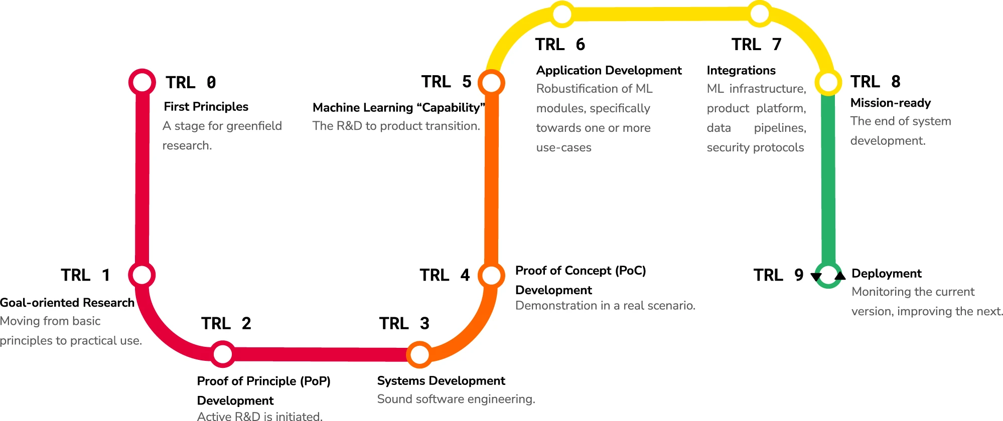
Minimum Technology Readiness Level
How developed should an AI solution be to apply for Phase 1?
  AI-enabled tools should be at Technology Readiness Level 3 or higher to be eligible for this opportunity.
Source: Lavin, A., Gilligan-Lee, C.M., Visnjic, A. et al. Technology readiness levels for machine learning systems. Nat Commun 13, 6039 (2022). https://doi.org/10.1038/s41467-022-33128-9

Slide 15
Potential Support
If offered, what type(s) of expert(s) would you like to connect with prior to submitting your Phase 1 Application?
    Connecting with fellow innovators to create collaborative applications for the Challenge.
    Access to caregivers to provide insights or feedback
    Access to technology and AI experts
    Access to federal staff to address questions
Phase 2 and 3 of the Challenge will provide applicants additional technical assistance and opportunities to connect with subject matter experts and stakeholders.

Slide 16
Potential Support (cont.)
What is the scope of the term "caregiver" as defined by the competition?
  The definition of “caregiver” is provided on the Challenge Definitions, FAQs, and Resources page and references the definition set out by National Strategy to Support Family Caregivers.
Does this challenge include solutions for caregivers of children?
  This challenge is exclusively focused on caregivers for individuals with disabilities and older adults. The term individuals with disabilities may include children with disabilities. It would be out of scope to have solutions designed solely for caregivers of children without disabilities.
  For a solution to be eligible, it must be primarily designed to meet the needs of caregivers supporting individuals with disabilities or older adults or include specific adaptions that meets their needs. Incidental or secondary benefits to these populations are not sufficient.
Do home and community environments include nursing homes and other institutional settings?
  No, this challenge does not include institutional care settings in its scope.

Slide 17
Questions
How does the Challenge define disability?
  The Challenge defines disability based on the Americans with Disabilities Act.
What types of organizations eligible?
  Non-profits, for-profits, government agencies, cross-organizational partnerships, teams, and individuals are all eligible to participate in the Challenge. Any of these organizations or groups can be the primary applicant.
  The America COMPETES Act limits eligibility to U.S. citizens, residents and companies.
Will ACL support scaling through federal programs or Medicaid Waiver Systems?
  While we will support scaling in Phase 3, ACL does not have control or influence over other federal programs. We will be able to connect teams to the relevant stakeholders for the different programs.

