Slide 1

Data Workshop Series
Identifying and Aligning Data Sources and Understanding Gaps
Julie Bershadsky
Associate Director for Research, ICI, UMN
February 12, 2026

Slide 2
Agenda
Introduction and Overview
State Insights: Kansas
Data Workshop Series
Identifying and Aligning Data Sources and Understanding Gaps
Q&A
Small Group Discussions and Report-Outs

Slide 3
Speaker
Nicole Howell, BA
Director, DCW Strategies Center

Slide 4
Building national capacity to support community living
Provide tools and training to assist
state systems and service providers
Facilitate peer-to-
peer sharing of lessons learned and promising systems-change practices
Created by the Administration for Community Living in 2022, the Direct Care Workforce Strategies Center (Strategies Center) provides technical assistance to states and service providers and facilitates collaboration with stakeholders to improve the recruitment, retention, training, and professional development of members of the direct care workforce.
Maintain a clearinghouse of resources and promising practices
Notes:
Brief description of the Center option 1

Slide 5
The DCW Data Collection Workshop Series
Part 1
Identifying and Prioritizing Workforce Questions and Data Sources
Part 2
Identifying and Aligning Data Sources—and Understanding Gaps
Part 3
Evaluating the Impact of Direct Care Workforce Investments
February 12, 2026
February 26, 2026
January 29, 2026

Slide 6
Identifying and Aligning Data Sources and Understanding Gaps

Slide 7
Today’s Goal and Objectives
Participants will learn how to set a clear strategy for developing state-level direct care workforce data infrastructure and practices by:
1
Understanding your data sources
2
Aligning your data sources to your workforce questions
3
Understanding gaps

Slide 8
Quick refresh – last time
1) Identifying and engaging partners
2) Defining the workforce
3) Specifying data needs
4) Exploring data sources
Now what?

Slide 9
Three Steps Toward a Strategic Workforce Data Approach
1
Understanding your data sources

Slide 10
What to understand – and catalogue – about your data
Administrative details
Population & coverage
Data elements included
Data characteristics
Data quality & limitations
Linkage & integration
Access & use

Slide 11
Digging into your data
Administrative details
Data source name
Owning agency/division
Primary purpose of data collection
Statutory/regulatory basis (if applicable)
Data steward/owner and contact person
Population & coverage
Programs included
Service settings included
Workforce types included
Geographic coverage
Sampling or population-based

Slide 12
Digging into your data, continued
Data characteristics
Data type
Unit of analysis
Collection frequency
Most recent data available
Data elements included
Workforce size & composition
Stability
Compensation & benefits
Training & credentials
Demographics
Worker experience

Slide 13
Digging into your data, continued
Data quality & limitations
Completeness of key fields
Data validation
Known gaps or limitations
Consistency of definitions over time
Linkage & integration
Unique ID
Can be linked to other systems
Overlaps with other data sources
Can be exported/formatted for analysis

Slide 14
Digging into your data, continued
Access & use
Who can access the data
Current uses
Includes PII
Reporting burden
Current cost to collect/maintain data source

Slide 15
Three Steps Toward a Strategic Workforce Data Approach
2
Aligning data sources to workforce questions

Slide 16
Evaluating your data sources
Evaluate in relation to your key workforce questions/data needs along multiple dimensions:
Coverage
Content
Quality
Timeliness
Integration potential (if applicable)

Slide 17
Evaluating your data sources, continued
Can assign a score to each dimension
Example:
Data quality: Poor (1) / Inconsistent (2) / Generally reliable (3) / High (4)
The higher the total score – the more aligned

Slide 18
Three Steps Toward a Strategic Workforce Data Approach
3
Understanding gaps

Slide 19
Understanding gaps
Low-scoring dimensions = gaps
What information is missing?
E.g.: Data element:________
Population:________
Settings/programs: ________
Geography/time: ________
Why does it matter?
I.e., impact on key workforce questions

Slide 20
Understanding gaps, continued
What are the root causes for this gap?
E.g.: policies, system/technology limitations, cost, reporting burden, lack of coordination, something else?
Prioritize gaps: quick wins vs long-term fixes
Prioritize based on:
Impact on key workforce questions
Feasibility (cost, time, burden, etc.)

Slide 21
Lessons from the Field: State Insights on Workforce Data Solutions
Kansas

Slide 22



State Spotlight: Kansas
Carrie Wendel-Hummell, PhD
Principal Investigator -- ARPA DSW Development Projects
University of Kansas/ Children’s Mercy Research Institute
Theresa Singh, MPA
HCBS Training Specialist
Kansas Department for Aging and Disability Services (KDADS)
Notes:
Theresa

Slide 23

Kansas Recognized the Need for Direct Support Worker (DSW) Workforce Data to:
Assess needs and inform design of DSW workforce initiatives, such as the training and career ladder programs (immediate)
Gauge the effectiveness of these workforce initiatives (long term)
Improve legislative buy-in for investing in this workforce (ongoing)
Notes:
Theresa
Read slides, note that #1 is largely done but 2 &3 continue

Slide 24
Kansas needed to align DSW workforce initiatives, including data collection:
ARPA funded projects with KU to develop a training and career ladder program (2023-2025)
  Workforce analysis based on surveys, EVV data, BLS data, and Census data
KanCare contract renewals with new workforce development expectations of the MCOs (2025-present)
  New contracts require MCOs to "improve the capacity and capabilities of the direct care workforce," including by collecting data to monitor workforce capacity and must have a workforce development manager
  3 KanCare MCOs: Healthy Blue, Sunflower, UnitedHealthcare
  Initial year spent aligning and operationalizing efforts
Notes:
Theresa
KU: (read slide) projects and data analysis is complete.
EVV: Electronic Visit Verification; BLS: Bureau of Labor Statistics
2. KanCare: (red slide) – KanCare is our private Medicaid
MCOs initially submitted separate plans as part of the competitive bidding process, so first year was spent aligning these plans with each other and with the ARPA projects
Also put data collection on hold to be more thoughtful about collecting useful data that did not duplicate other data sources
After reading slide:
Note the different but overlapping timing of these initiatives – when KDADS and KU were envisioning and carrying out the ARPA funded projects, we did not know that the new KanCare contracts were going to have new requirements to assess and support the direct support workforce. Likewise, when MCOs worked on their initial workforce development proposals, these were largely divorced from the ARPA projects as those projects weren’t yet fully visible – due to silos in the system and also because they hadn’t yet been launched publicly. The new KanCare contracts started 1/1/2025, which was then the last year of the ARPA projects, which were then at that point well underway and starting to be publicly launched. Thus, much of 2025 was spent aligning these efforts and many of the MCO plans are still being operationalized.
Our TA with the DCW Strategies center has really helped our state with aligning these efforts.

Slide 25
KU’s DSW Workforce Analysis: Surveys
  Baseline surveys aimed to collect data on workforce needs and outcomes, such as service recipient satisfaction with care, DSW job satisfaction, worker retention, and training needs
    103 service recipient surveys
    124 DSW surveys
    105 agency provider surveys
  Behavioral Economics Survey with 405 DSWs to collect data on DSW career goals and desires
Notes:
Carrie

Slide 26
KU’s DSW Workforce Analysis: Surveys
  The Concerns Report Method compares the importance of job factors to DSWs with their satisfaction with these factors.
Top 5 Strengths (high importance and high satisfaction) | Score
Relationships with care recipients | 88.8
Feeling work is meaningful | 78.8
Workplace safety | 74.5
Comfortable/equipped workplace | 71.6
Job Security | 71
Top 5 Weaknesses (high importance but low satisfaction) | Score
Performance Bonuses | 45.7
Health Insurance | 42.3
Paid Time Off | 40.3
Retirement Benefits | 40.2
Employee Recognition | 39.5
Notes:
Carrie: For sake of time, do not need to go over. Provided as an example of output. People can look at slides later if they want to spend more time with this.

Slide 27
KU’s DSW Workforce Analysis: AuthentiCare EVV Data
  EVV (Electronic Visit Verification): Timeclock and verification system for all HCBS-funded DSWs who work in home-based settings
  KU analyzed the 2024 AuthentiCare data set, containing records of over 27,800 service participants and 25,600 DSWs
  We learned that in 2024:
    77.5% of our home-based DSW workforce is self-directed (SD)
    Individuals who are self-directed grew by 6.1%, but SD workers only grew by 4.9%
    Approx. 38% DSW turnover rate, with higher turnover in agency-based compared to SD
  With additional time and data quality improvements, potential to track:
    More precise turnover rate, longitudinally
    Unfilled care hours (service participants)
    Scheduling and hours trends (workers)
    Geographic distributions
Notes:
Carrie
Highlights only
Does not include residential or day service DSWs
Self-directed – of whom over half are family or household members
Missing data and other data anomalies prevented us from analyzing everything we hoped to assess, but this was very much a pilot which allowed us to give the state feedback on needed data quality improved, that if addressed, would allow the state to also track these other trends …

Slide 28
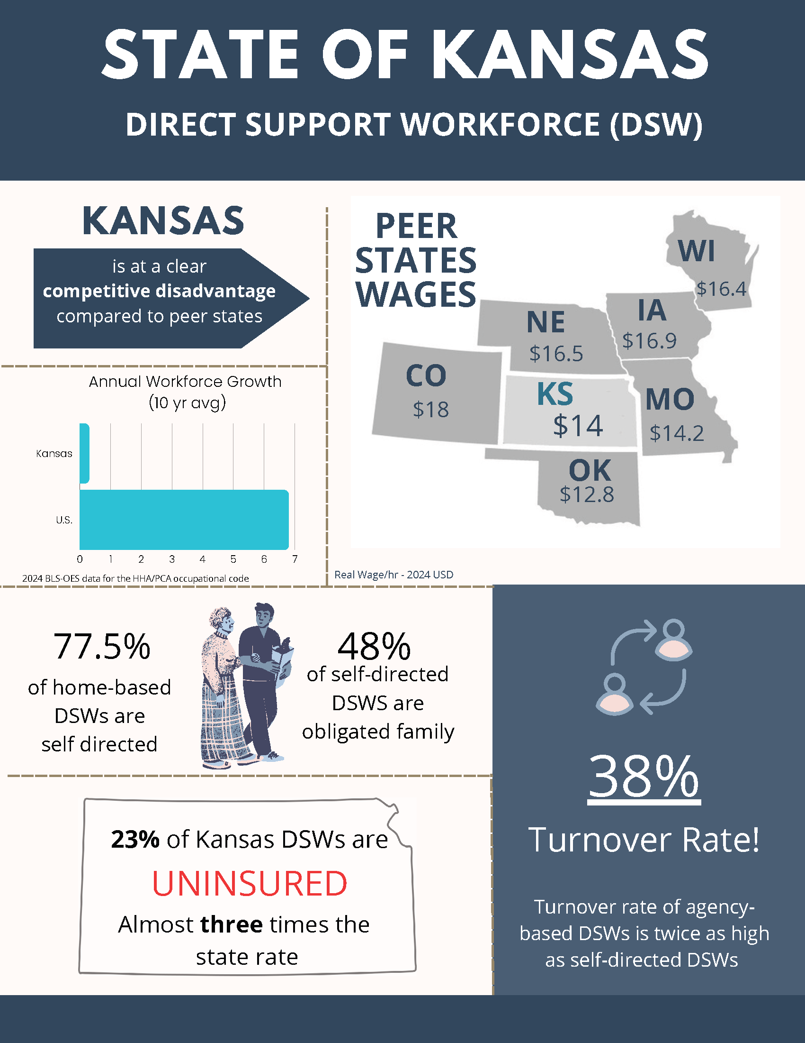
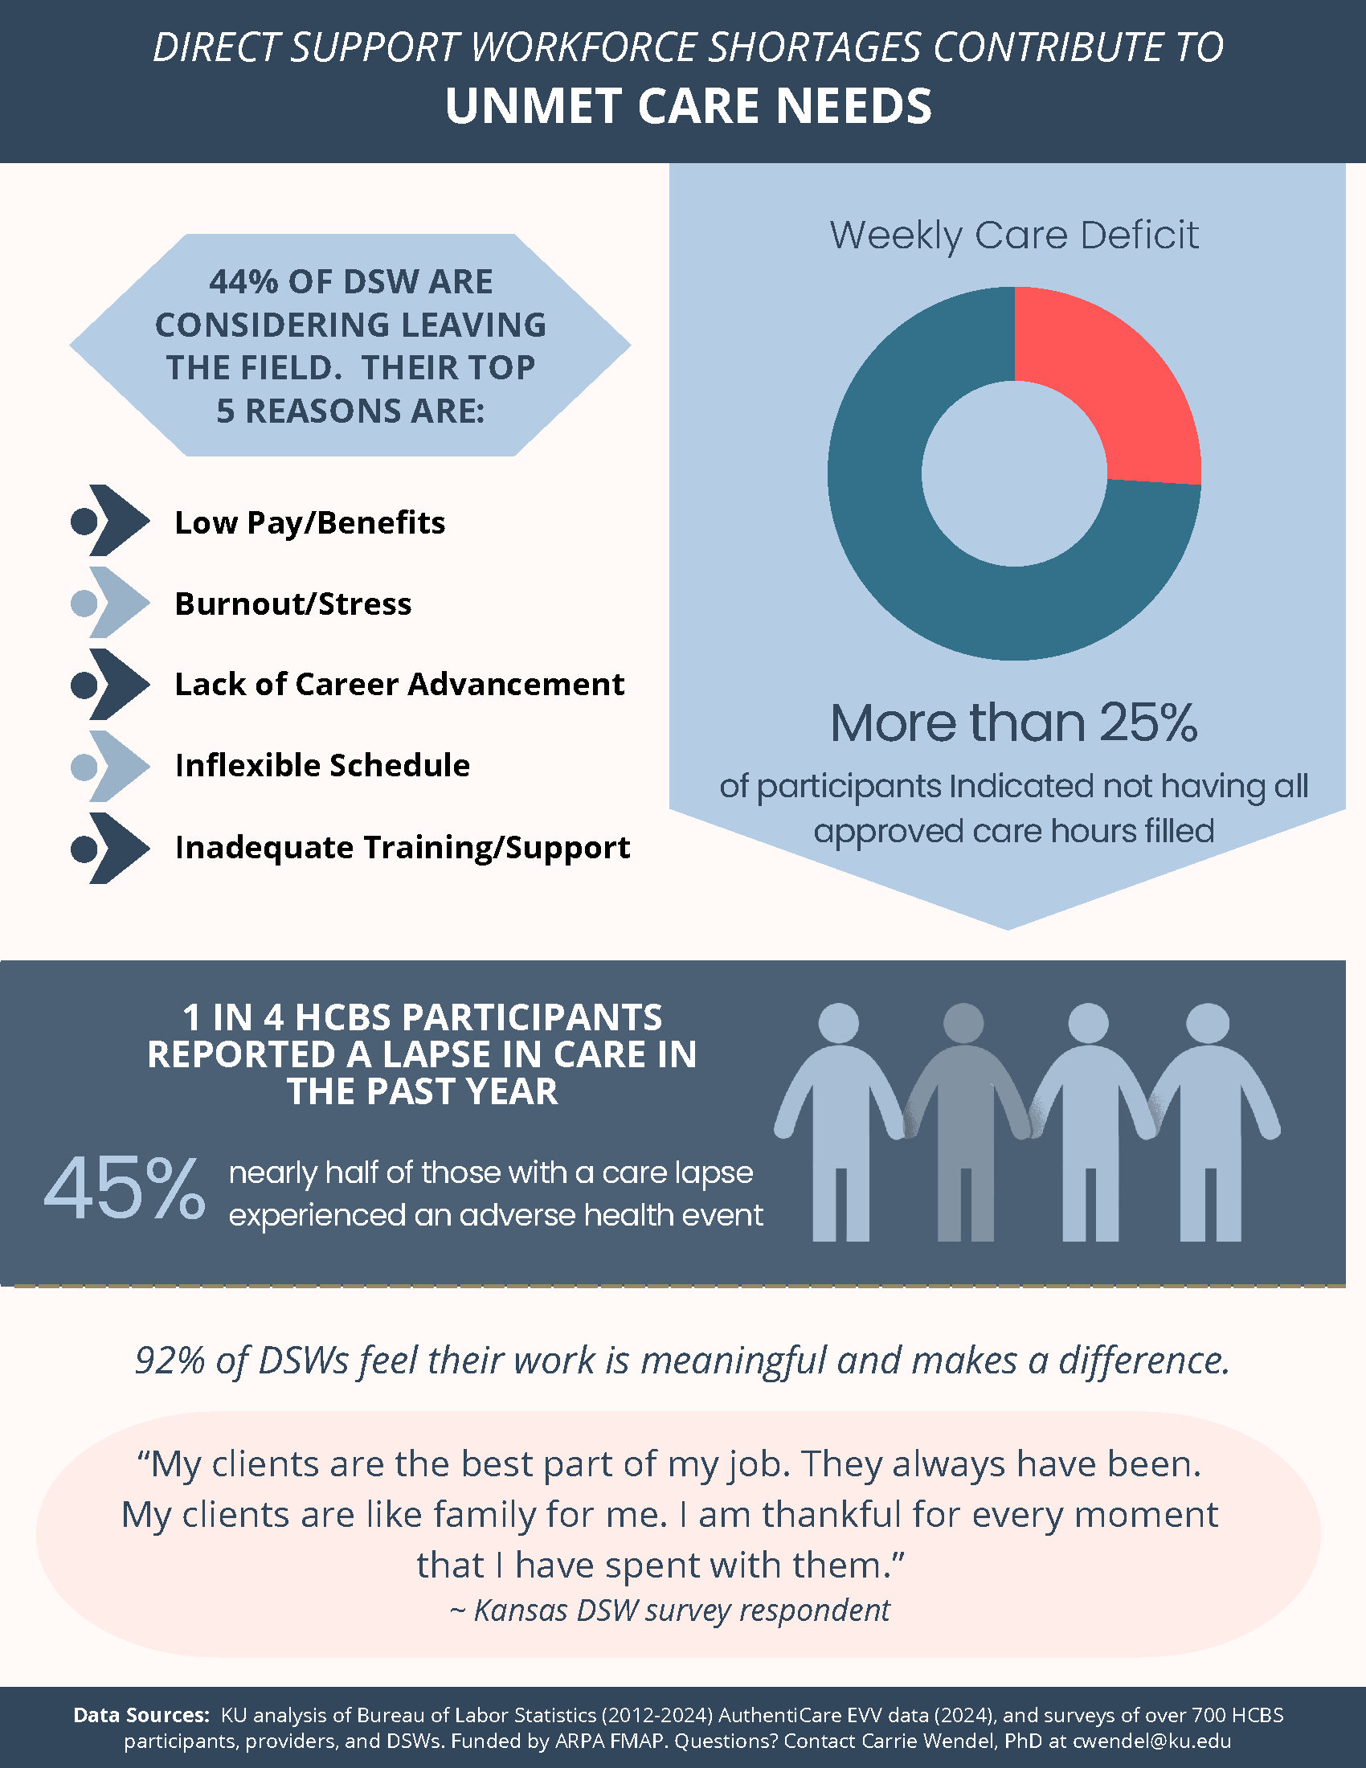
Using Data to Educate Policy-Makers
Notes:
Carrie
Infographic. Do not need to go over – in slides for people who want to view after or can also put in Teams chat as an attachment. For the point that data can educate policy-makers.

Slide 29
KanCare MCO Proposals
  MCO Workforce Managers meet weekly to align efforts
  Reinitiate Direct Support Workforce Advisory Council
    To advise on all workforce development efforts, including workforce data
  Continue stakeholder surveys, drawing on the KU surveys
    Service recipients, DSWs, providers
Notes:
Theresa
Proposals – operationalization is still in progress
As a reminder, 2025 was the first year of the new KanCare contracts with the new workforce development requirements – this year was largely spent aligning efforts and planning, a lot of progress has been made, but we are still in this stage. We are still in the planning and operationalization phase, but these are some plans that MCOs have for the upcoming year that related to direct support workforce data. MCOs have submitted additional plans for supporting the workforce, but here we are focused primarily on those related to data collection
Advisory board: KU had convened an advisory board to advise on the ARPA funded training and career ladder projects, the MCOs would like to revamp and continue this effort now that the ARPA funding has ended.
Stakeholder surveys: The ARPA funded surveys provided a lot of valuable data, and MCOs are interested in continuing stakeholder surveys to continue assessing needs and outcomes. This is important for that long term goal of gauging the effectiveness of capacity building efforts.

Slide 30
For Additional Consideration
  MCOs must collaborate to strengthen the direct support workforce
    DSWs are a vital component of network adequacy
    MCOs share the DSW workforce
  Avoid burdening providers with duplicative data requests
    Don’t request data that can be found in administrative data (e.g., EVV data, claims data)
    Adopt a single web-based platform for collecting/tracking DSW records and data
      E.g., DSW background check compliance and reminders; collect workforce data from providers; self-direction matching service registry; tracking DSW trainings and certifications
  Consider the role of the External Quality Review Organization (EQRO)
    National Core Indicators – State of the Workforce Surveys
Notes:
Theresa
1st bullet: MCOs share the DSW workforce – DSWs are not MCO employees or MCO members, and DSWs often work with members across all 3 MCOs
2nd bullet:
Web platform – these are proposed functions – details and vendor still being worked out.
3rd bullet: EQRO: Managed care states are required to have an EQRO to monitor MCO performance. States should consider performance metrics on the strength of the Direct Support Workforce as key HCBS providers. For example, Kansas already uses the NCI service participant surveys and is now considering having our EHRQ start using the NCI state of the Workforce Surveys in their new contract. In finalizing this decision, it’s also important to be mindful that MCOs and EHRQs are not duplicating their efforts – it would be burdensome and frustrating to providers if both the MCOs and EQROs were sending different surveys collecting similar information to providers. This is also an example of pausing data collection to be thoughtful in collecting useful data that will not overly burden our HCBS providers.

Slide 31
Questions?
Theresa Singh
HCBS Training Specialist
Kansas Department for Aging and Disability Services
Theresa.Singh@ks.gov
Notes:
Theresa

Slide 32
Identifying and Aligning Data Sources and Understanding Gaps
Breakout Room Discussion

Slide 33
Join us for the next workshop!
Evaluating the Impact of Direct Care Workforce Investments
February 26, 2026

Slide 34

Aligning data sources to workforce questions
Workforce Data Planning Tool
Use the tool that accompanies this webinar to work with colleagues to:
Evaluate your data sources in relation to your key workforce questions
Identify gaps
Consider reasons for these gaps

Slide 35
Contact
Julie Bershadsky
Bers0017@umn.edu
Associate Director for Research, ICI, UMN
Theresa Singh
Theresa.Singh@ks.gov
HCBS Training Specialist, Kansas Department for Aging and Disability Services (KDADS)
Carrie Wendel-Hummell
Principal Investigator – ARPA DSW Development Projects, University of Kansas/Children’s Mercy Research Institute

Slide 36
Thank You
Final Reminders
Please be sure to join us for part 3 of this series on February 26th
Check out resources on our website and sign up for Center updates at: https://acl.gov/DCWcenter
Please complete the post-workshop evaluation in the chat

Slide 37
End

