Slide 1

Data Workshop Series
Evaluating the Impact of Direct Care Workforce Investments
Kezia Scales, PhD
VP of Policy, Research, & Evaluation, PHI
February 26, 2026
Notes:
Hello and thank you for joining us for this third and final installment of the Direct Care Workforce Strategies Center Data Workshop Series.
I am Kezia Scales, Vice President of Policy, Research, & Evaluation for PHI, a national organization dedicated to improving job quality for direct care workers as the foundation of quality care for older adults and people with disabilities.
PHI is proud to be one of the national partners supporting the Strategies Center, along with the Institute on Community Integration at the University of Minnesota—who co-leading this workshop series—and other awesome partners.

Slide 2
Agenda
Introduction and Overview
State Insights: Michigan
Data Workshop Series
Evaluating the Impact of Direct Care Workforce Investments
Summary of Workshop Tools
Q&A and Discussion
Notes:
We have 90 minutes together today and here’s the plan —
We’ll hear from Nicole Howell, the Director of the Strategies Center, in just a moment, and then I’ll come back on to present four formative steps in evaluating workforce investments—and then we’ll get to hear from Dr. Clare Luz from Michigan State University and the IMPART Alliance, who will share her state’s approach to strengthening the direct care workforce and evaluating the impact of that approach.
We’ll end today not with small-group discussions, as in the previous sessions, but with a walk-through of each of the tools that has been designed for and shared through this workshop series, to inspire your thinking and next steps—followed by an open forum for questions and conversation.

Slide 3
Speaker
Nicole Howell, BA
Director, DCW Strategies Center
Notes:
Over to Nicole…

Slide 4
Building national capacity to support community living
Provide tools and training to assist
state systems and service providers
Facilitate peer-to-
peer sharing of lessons learned and promising systems-change practices
Created by the Administration for Community Living in 2022, the Direct Care Workforce Strategies Center (Strategies Center) provides technical assistance to states and service providers and facilitates collaboration with stakeholders to improve the recruitment, retention, training, and professional development of members of the direct care workforce.
Maintain a clearinghouse of resources and promising practices

Slide 5
Evaluating the Impact of Direct Care Workforce Investments
Or: How to Turn Effort+Data into Evidence
Notes:
Thank you, Nicole!
So today we’re talking about evaluation — OR, how to turn effort plus data into EVIDENCE — that is essential for making and sustaining the real improvements that you seek.

Slide 6
Recap: Previous Workshops
Part 1: Identifying and Prioritizing Workforce Questions and Data Sources
Identifying and engaging partners
Defining the workforce
Specifying data needs
Exploring data sources
Part 2: Identifying and Aligning Data Sources—and Understanding Gaps
Understanding your data sources
Aligning data sources to your workforce questions
Understanding gaps
Notes:
First, to quickly recap—we started the workshop series with PHI’s Stephen McCall guiding us through the process of identifying and prioritizing workforce questions, overall, and data sources—and then ICI’s Dr. Julie Bershadsky helped us think further about identifying and aligning data sources, as well as understanding the gaps. Each of those experts will talk through these steps again briefly later when summarizing the tools that you’re taking away with you.

Slide 7
Today’s Goal and Objectives
Participants will learn key steps in designing an evaluation plan for a particular investment or initiative, including:
1
Engaging partners
2
Creating a logic model
3
Crafting evaluation questions
4
Developing a measurement framework
Notes:
TODAY, we’re going to talk through key steps in designing an evaluation plan for a particular investment or initiative, which includes engaging partners, creating a logic model, crafting evaluation questions, and developing a measurement framework.
And I’ll do my best to do justice to this pretty ambitious amount of content in about 20 minutes.

Slide 8
Why Evaluate?
Track Implementation: Is the investment or initiative implemented as planned? Are funds and efforts allocated as intended? Are the right partners involved?
Assess Progress: What is working so far—and what is not? What barriers have been encountered? What mid-course corrections might be needed?
Document Impact: How effective is the investment or initiative? What outcomes have been achieved? Who has benefitted and how?
Inform Decisions: Make or promote evidence-informed decisions about where to allocate resources, e.g. through scale-up, a sustainability plan, or a new approach.
Communicate Success: Communicate with key audiences in compelling ways to build awareness, generate support, and encourage action.
Notes:
But first — why evaluate, given the extra time and resources required to do so? Can we just do the thing and move on?
Here are some reasons: READ

Slide 9


Key Resources
https://www.betterevaluation.org/sites/default/files/WKKF_StepByStepGuideToEvaluation_smaller.pdf
https://www.naccho.org/uploads/downloadable-resources/Programs/Public-Health-Infrastructure/KelloggLogicModelGuide_161122_162808.pdf

Slide 10
Four Steps in Designing an Effective Evaluation Plan
1
Engaging Partners
Notes:
So where do we start? By engaging partners.

Slide 11
Engage Partners in Planning the Evaluation
Critical questions for partner input include:
What results are expected from the strategy, initiative, or program?
What will success look like? How will we know when we have achieved it?
What factors might help or hinder success?
What potential benefits and harms of evaluation should be assessed?
Who or what are the best data sources?
Who else should be consulted on the evaluation plan and informed of the results?
Notes:
We’ve already talked in this series about engaging partners, but I’m repeating that step here because an evaluation may need additional or different input than a broader workforce data-related effort.
The types of questions that partners can help specify and address include: READ

Slide 12
Planning Tool for Partner Engagement
Interested party | Mode of engagement | Cost and other considerations | Role in evaluation | Frequency of engagement
e.g., Direct care workers | Listening sessions | Travel and related expenses (if held in person) | Inform definition of success, key metrics, benefits and harms | Beginning and midpoint of project
e.g., Evaluation partner | Evaluation project team | Consulting costs | Help design and implement evaluation | Ongoing from outset of project
Etc…
Notes:
Here’s a structured and strategic way to think about partner engagement—because you don’t need or want everyone to be in every meeting (nobody wants that).
You can think about identifying all potential partners or interested parties, per that first column—and then for each, you can think through:
The best mode of engagement—through listening sessions, in advisory groups or workgroups, on the project team, as occasional subject matter experts?
What costs may be involved?
What role should each partner play, through the relevant mode of engagement? Are they helping answer those big questions about what success looks like and what benefits and harms to consider? Or directly helping to design and implement the evaluation? Or locating data sets or communicating the findings or other roles?
And finally how often might you plan to engage each expert—once or twice at key junctures? Or on a more regular cadence?

Slide 13
Four Steps in Designing an Effective Evaluation Plan
2
Creating a Logic Model
Notes:
Then, with all the right people on board, consider creating a logic model to describe and guide your efforts.

Slide 14
What is a Logic Model?
A logic model is a systematic, visual way to articulate how and why a specific strategy, investment, or program will achieve a set of desired results.
Logic models can be used to:
Design a strategy, initiative, or program
Inform implementation of a strategy, initiative, or program
Develop evaluation questions and an evaluation plan
Organize content for evaluation reporting
Improve a strategy, initiative, or program
Notes:
[wave your hand if you used logic models in your work. / Know about but have never used / Never heard of?]
READ DEFINITION
So in other words, the logic model is a way to formalize your thinking about what you’re trying to achieve and how you’re going to get there.
Logic models can be used in different ways at different points in your journey.
You can use a logic model to …. READ

Slide 15
Components of a Logic Model
Inputs/
Resources: Budget, staffing, infrastructure, materials, etc. that will be dedicated to the effort
Activities: The actions taken to achieve the desired results
Outputs: The tangible, direct products of the activities
Outcomes: The changes that are expected; may include short-, intermediate-, and long-term outcomes
Rationale and Assumptions: Why will the effort produce results? What factors that are necessary for success are already in place?
Problem Statement: What problem does this strategy, investment, or program seek to solve?
Goal: The overall aim or intended impact of the effort
Context/External Factors: Other factors influencing the results the strategy, investment, or program
Notes:
So here are the components of a logic model — acknowledging that there are lots of variations out there, so you can use this version, you can use another version — but generally, the components include….
Read Problem Statement, Goal
Essentially the goal is the resolution of that problem you’ve identified.
And then you have the core of the model — READ
Context/External Factors — that you know in advance will influence your results or that emerge or come to your awareness over time — because you can update the logic model to reflect your evolving understanding or approach, it is not set in stone for evermore.

Slide 16
Workforce Specific Examples
Problem Statement – Recruitment or retention challenges, training gaps
Goal – Improved job quality, workforce stability, service quality, system capacity
Rationale – New or improved X will lead to Y
Assumptions – Workforce will remain a priority, funds will be appropriated
Inputs/Resources – Funding, staff, partnerships, data systems
Activities – Wage enhancement, training, career pathways, coaching
Outputs – What was accomplished/delivered, who was reached
Outcomes – Wages, recruitment, retention, skills, career advancement
Notes:
What kinds of things might we expect to see in a logic model about a direct care workforce strategy or program?
Get as specific as possible in the problem and goal statements.
Rationale – hypothesis; here’s why we’re taking this approach, here’s what we think is going to happen
Assumptions — other political or policy-related or social and cultural and environmental factors that your approach rests or relies on

Slide 17
Four Steps in Designing an Effective Evaluation Plan
3
Crafting Evaluation Questions
Notes:
We could probably spend a day on logic modelling but we’re going to zoom ahead to talk briefly about how to craft specific evaluation questions … using your logic model.

Slide 18
Using the Logic Model for Evaluation
Inputs/
Resources: Budget, staffing, infrastructure, materials, etc. that will be dedicated to the effort
Activities: The actions taken to achieve the desired results
Outputs: The tangible, direct products of the activities
Outcomes: The changes that are expected; may include short-, intermediate-, and long-term outcomes
Rationale and Assumptions: Why will the effort produce results? What factors that are necessary for success are already in place?
Problem Statement: What problem does this strategy, investment, or program seek to solve?
Goal: The overall aim or intended impact of the effort
Context/External Factors: Other factors influencing the results the strategy, investment, or program
Formative Evaluation
Summative Evaluation
Notes:
As I said earlier, you can use your logic model to determine what you want to learn through your evaluation.
If you’re primarily at this point interested in whether and how the work is getting done (to assess progress and course correct as needed), then you’ll focus your evaluation questions on the first part of the logic model—and you’ll conduct a formative or process evaluation [CLICK]
If you’re ready to assess whether your efforts led to the results you were seeking, then you’re looking ALSO or INSTEAD at the outputs and outcomes—through a summative or impact evaluation [CLICK]

Slide 19
Types of Evaluation
Formative Evaluation — Improve
Summative Evaluation — Prove
Also known as process evaluation
Focuses primarily on program activities and outputs (also short-term outcomes)
Ensures accountability, i.e. resources are managed well and used as intended
Allows for monitoring and timely reporting on progress toward goals
Helps identify challenges and barriers and informs mid-course corrections
Also known as outcome or impact evaluation
Focuses primarily on results, i.e. outcomes
Allows assessment of whether the initiative worked
Helps determine whether the effort is sustainable and replicable
Supports effective communication about the initiative
Notes:
Just to say a bit more about those two types of evaluation – READ
Acknowledge nuances between each one — this is broad-brush distinction

Slide 20
Developing Evaluation Questions from the Logic Model
Process
Impact
Investment
Was the effort implemented on schedule and as intended?
Why/why not? What factors helped or hindered success?
What lessons were learned?
To what extent did the effort lead to the anticipated results?
What changes occurred and to what extent did this effort contribute to those changes?
What were the unintended benefits? Unintended consequences?
Was the effort cost effective?
What was the return on investment?
What alternative approaches may have represented better investment and outcomes?
Notes:
Breaking it out a little further, here are some domains from across the logic model that you may want to address through your evaluation questions.
First, and somewhat repeating myself, there are the process questions…. READ
And then there are the Impact questions….
But, relatedly but distinctly, there are investment-specific questions.. READ

Slide 21
Developing Evaluation Questions from the Logic Model
Context
Overall Strategy
Next Steps
What demographic, economic, social, political, or other factors influenced implementation and outcomes?
What internal factors might have affected the effort, e.g. staffing, budget, priorities?
Was the logic model correct/ appropriate/ helpful?
What aspects of the logic model did not happen in practice and why or why not?
What continued investment/oversight is required to sustain the effort?
Can and should the effort be scaled up?
Can and should the effort be replicated elsewhere?
Notes:
It’s important to set these questions in advance because you may want to implement some kind of documentation process versus just looking back at the end and trying to remember what happened contextually that may have impacted your success.
Logic model – did what you envision in advance as the logical progression of inputs to activities to outputs to outcomes pan out? And if not, which part of the logic fell apart? What new logical pathways may need to be explored instead?
The most global set of questions is about next steps—looking at the totality, the full set of activities and outcomes — where do we go from here. READ – why or why not

Slide 22
Assessing and Refining Evaluation Questions
Review and revise your evaluation questions, considering:
Have a variety of audiences been considered when crafting the questions?
Have the highest priority questions been selected?
Will each question generate useful, actionable insight?
Is it clear how each question relates to the logic model?
Are the questions specific about what information is needed?
Do the questions capture lessons learned along the way?
Notes:
So you create your logic model, you craft your evaluation questions — and then you review and refine them—considering questions like:
READ
Audiences — and relatedly, which questions will meet the interests and needs of the widest range and/or the most important audiences
Priority— in other words, are there some questions that would be nice to know, but are not actually the highest priority
Lessons learned — even if you’re focused primarily on outcomes, are you going to be prepared to speak to how you got there and what you learned in the process, because that’s so important for replication or scale-up

Slide 23
Four Steps in Designing an Effective Evaluation Plan
4
Developing a Measurement Framework
Notes:
The final step that we’ll touch on today, or really just signpost toward—is developing a measurement framework. This step, when you get there, will pull in all of that good work related to defining the workforce and operationalizing your key concepts and identifying and assessing your data sources and data gaps — this is kind of where it all comes together — which is why I wanted to present it, albeit without getting into too much detail.

Slide 24
Components of a Measurement Framework
Output/Outcome – Specific outputs or changes expected; pull directly from logic model
Indicator – Specific markers indicating achievement or progress
Measures of Change – Actual value for assessing progress
Data Source – Where data will be collected/obtained
Data Frequency – How often data will be collected/obtained
Notes:
Your measurement framework is your blueprint or roadmap for pulling together or collecting the data that will help answer the evaluation questions that you crafted from your logic model.
So here are the components, and I’ll take through a visual example in a moment.
Indicator is the type of change, the measure of change is the actual change

Slide 25
Example: Wage Floor Policy
Output/Outcome | Indicator | Measure of Change | Data Source | Frequency of Data
Output | Output | Output | Output | Output
Wage policy implemented | Wages adjusted up to the wage floor as needed | Wages for all eligible worker wages who were paid less than the wage floor have been adjusted up | Employer attestation | Annual
Outcome | Outcome | Outcome | Outcome | Outcome
Improved earnings for eligible workers | Higher monthly income for eligible workers | Number of workers reporting higher monthly income | Workforce survey | Annual
Notes:
Over-simplified
Problem statement — Noncompetitive wages are driving turnover in the direct care workforce (“my workers are leaving because they can make $1 more an hour at Target or a local equivalent”)
Goal – Improved workforce stability and continuity of care for consumers
Rationale — setting a wage floor at 150% of the minimum wage for direct care workers supporting consumers through specified HCBS waiver programs will raise wages to a more competitive level, which will reduce attrition.
Activities to get that wage floor designed and implemented, with specified outputs and measurable outcomes.
And that’s where you start your measurement framework — READ through it

Slide 26
Learnings from the Field: State Insights on Workforce Data and Evaluation
Michigan’s Direct Care Workforce Integrated Strategies Model
Notes:
And now I am happy to pass the mic to Dr. Clare Luz who is one of the most knowledgeable and dedicated direct care workforce experts and advocates that you could ever hope to meet.
She is also a gerontologist and Associate Professor in Family and Community Medicine at the MSU College of Osteopathic Medicine, and she is the founding director of the IMPART Alliance, a group that is dedicated to transforming Michigan's direct care workforce to meet growing needs—and we’re so lucky to have her here today to offer insights from Michigan’s Direct Care Workforce Integrated Strategies Model.
Clare, over to you —

Slide 27
State Spotlight: MICHIGAN

Slide 28
Revisiting Direct Care Workforce Data and Evaluation Tools
Notes:
In the next part of the agenda, we’ll walk through each of the tools that we have shared through this workshop series, so that you have a clear sense of the full collection and you can ask questions if needed — so feel to put questions in the chat or raise your hand to ask in real time, or we’ll have time at the end for questions as well.

Slide 29

Data and Evaluation
Tools
Use the tools that were shared through this workshop series to work with colleagues to:
Identify and engage partners
Define the workforce
Specify data needs
Explore data sources
Understand data sources
Align data sources
Understand gaps
Engage partners (again)
Create a logic model
Craft evaluation questions
Develop a measurement framework
Notes:
Here’s a one-slide summary of all the practical data and evaluation steps that these tools are designed to inspire and support—an we’ll briefly go through each of them in turn.
Pass over to Stephen to talk through the components of the tool from session 1—and then Stephen, you can pass directly to Julie to recap the tool from the second session.

Slide 30
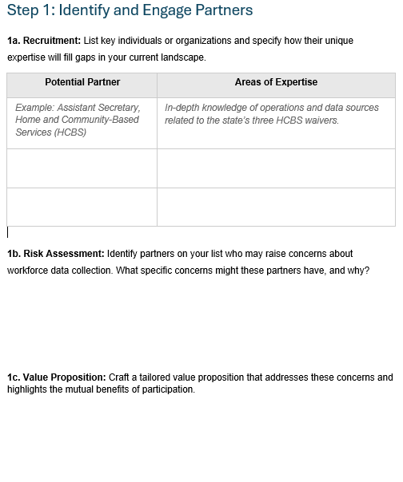
Identifying and Prioritizing Workforce Questions and Data Sources (Workshop 1)
Workforce Data Planning Tool
Step 1
Notes:
This tool guides you through four foundational steps for developing a strategic approach to improving direct care workforce data:
Identify and engage partners
Define the workforce
Specify data needs
Explore data sources
These steps lay the groundwork for developing stronger state-level direct care workforce data infrastructure and practices. Complete this tool collaboratively with your internal team. Document your decisions and rationale—this will guide your data development efforts and help communicate your approach to stakeholders.

Slide 31
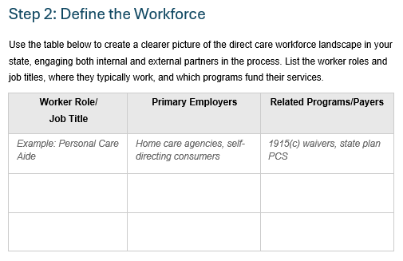
Identifying and Prioritizing Workforce Questions and Data Sources (Workshop 1)
Workforce Data Planning Tool
Step 2

Slide 32
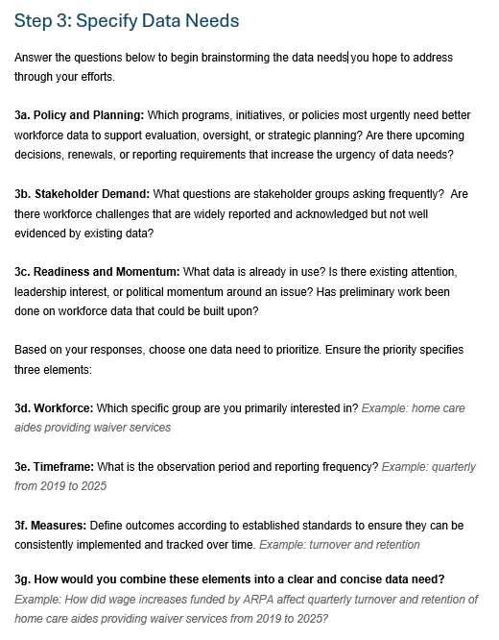
Identifying and Prioritizing Workforce Questions and Data Sources (Workshop 1)
Workforce Data Planning Tool
Step 3

Slide 33
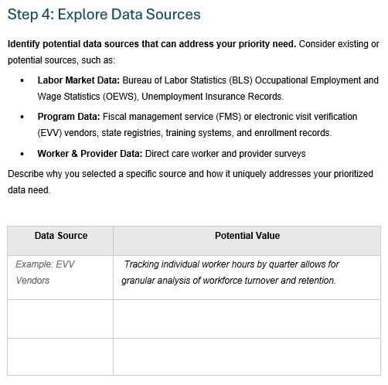
Identifying and Prioritizing Workforce Questions and Data Sources (Workshop 1)
Workforce Data Planning Tool
Step 4

Slide 34
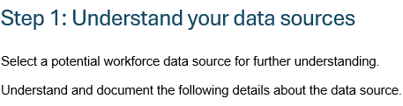
Identifying and Aligning Data Sources and Understanding Gaps
(Workshop 2)
Workforce Data Audit and Assessment Tool
Step 1
1a. Administrative details
1e. Data quality and limitations
1b. Population and coverage
1f. Linkage and integration
1c. Data elements included
1g. Access and use
1d. Data
characteristics
Notes:
This tool guides you through next steps for developing a strategic approach to improving direct care workforce data:
Understand your data sources
Align your data sources to your workforce questions
Understand gaps
These steps lay the groundwork for developing stronger state-level direct care workforce data infrastructure and practices. Complete this tool collaboratively with your internal team. Document your decisions and rationale.

Slide 35
Identifying and Aligning Data Sources and Understanding Gaps
(Workshop 2)
Step 2: Aling data source to the workforce question
Evaluate the data source in relation to your key workforce question along several dimensions below.
Dimension |  | Score = 0 | Score = 1 | Score = 2 | Score = 3
Coverage |  | Narrow | Partial | Most workforce | Comprehensive
Workforce Content |  | Minimal | Some elements | Many elements | Most or all elements
Data Quality |  | Poor | Inconsistent | Generally reliable | High quality
Timeliness |  | Old | intermittent and/or Inconsistent | Regular, short delay | Near real-time
Integration Potential (if applicable) |  | None | Limited | Some linkage | Easily linked
Workforce Data Audit and Assessment Tool
Step 2
Total score ___________
The higher the total score, the more aligned is the data source to your workforce question.

Slide 36
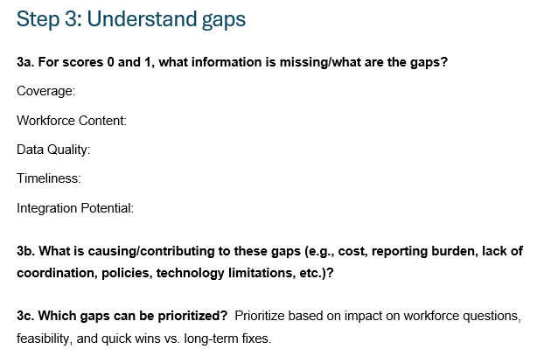
Identifying and Aligning Data Sources and Understanding Gaps
(Workshop 2)
Workforce Data Audit and Assessment Tool
Step 3

Slide 37
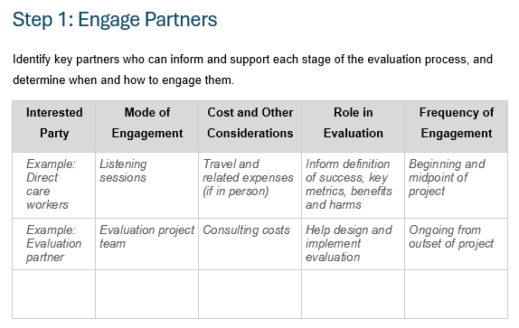
Evaluating the Impact of Direct Care Workforce Investments
(Workshop 3)
Evaluation Planning Tool
Step 1

Slide 38
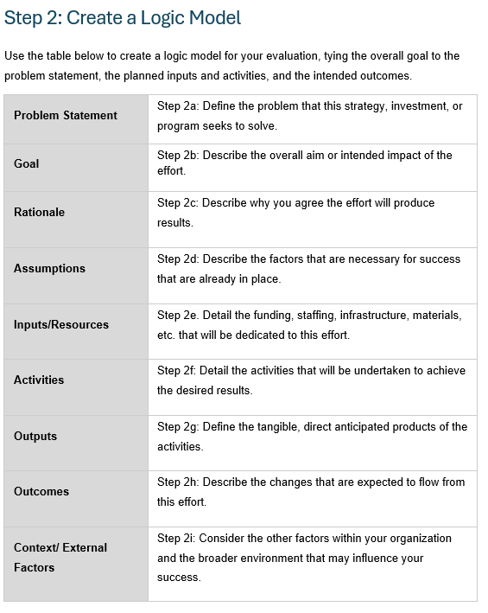
Evaluating the Impact of Direct Care Workforce Investments
(Workshop 3)
Evaluation Planning Tool
Step 2

Slide 39
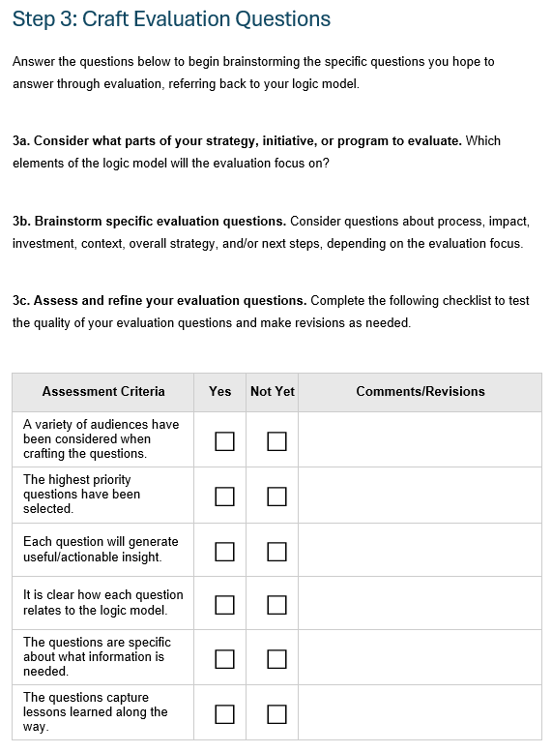
Evaluating the Impact of Direct Care Workforce Investments
(Workshop 3)
Evaluation Planning Tool
Step 3

Slide 40
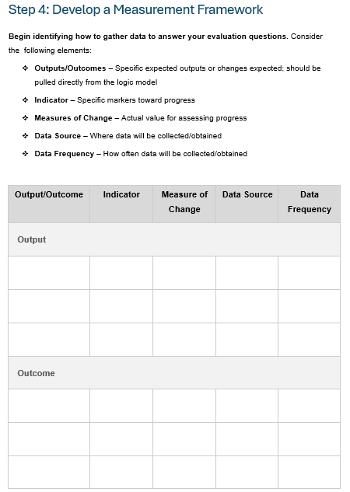
Evaluating the Impact of Direct Care Workforce Investments
(Workshop 3)
Evaluation Planning Tool
Step 4

Slide 41
Final Q&A: What Questions Do You Have for the Presenters and Other Participants?

Slide 42
Contact
Kezia Scales, PhD
kscales@phational.org
Vice President of Policy, Research, and Evaluation, PHI
Stephen McCall
smccall@phinational.org
Director of Research, PHI
Julie Bershadsky
Bers0017@umn.edu
Associate Director for Research, ICI UMN
Clare Luz, PhD
luz@msu.edu
Michigan State University, IMPART Alliance

Slide 43
Thank You
Reminders
Check out resources on our website and sign up for Center updates at: https://acl.gov/DCWcenter
Please complete the post-workshop evaluation in the chat

Slide 44
End

